Slide 1
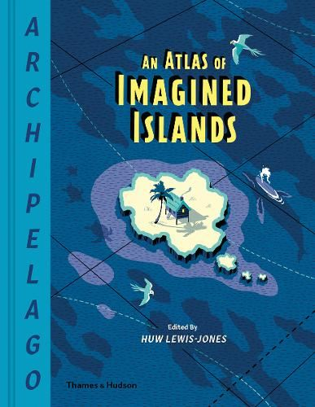
Year 6 – Autumn Term 1
In maths, this term the children will be focusing on:
the place value of numbers up to 10 million and negative numbers.
recapping strategies for the four operations (including long division and long multiplication).
In English we will be exploring maps that appear in fiction books using the book An Atlas of Imagined Islands as our stimulus. By the end of the term the children will:
Write a description based an imagined island.
Write a non-chronological report about an own imagined island.
Write a speech
Write a persuasive advert about their island and why tourists should visit it.
RE - Creation and Science – Conflicting or Complementary?
Outline the importance of Creation on the timeline of the ‘Big Story’ of the Bible
Consider what type of text people say Genesis is and its purpose
Make comparisons between what Christian's belief and Genesis 1
Weigh up how far the Genesis narrative is in conflict, or is complementary, with a scientific account.
Science - Evolution and Inheritance
- Recognise that living things have changed over time and that fossils provide information about living things that inhabited earth millions of years ago.
- Recognise that living things produce offspring of the same kind, but normally offspring vary and are not identical to their parents.
- Identify how animals and plants are adapted to suit their environment in different ways and that adaptation may lead to evolution.
Art and Design – Sculptures
Learn how to knead and wedge clay in preparation for sculpting
Use a range of skills including pinching, slabbing and coiling
Design and evaluate a Mayan Clay tile using clay
Computing
Use nested loops in their designs, explaining why they need two repeats.
Alter the house drawing using Python commands; use comments to show a level of understanding around what their code does.
Use loops in Python and explain what the parts of a loop do.
History – Who were the Ancient Mayans?
In history this term, we are going to be learning about who the Maya were and their impact on civilization and society today.
We will be making comparisons between others ancient civilizations that have been studied previously.
Across the term, we will be studying their beliefs and their way of life.
PE – Tag Rugby/Gymnastics
PSHCE – Family and Relationships
French – French Sport and the Olympics

