Slide 1
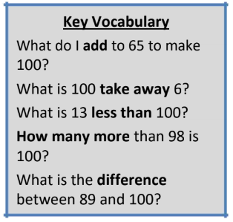
Year 4 – Term 1
I know number bonds to 100.
By the end of this half term, children should know the following facts. The aim is for them to recall these facts instantly.
Some examples:
60 + 40 = 100 37 + 63 = 100
40 + 60 = 100 63 + 37 = 100
100 – 40 = 60 100 – 63 = 37
100 – 60 = 40 100 – 37 = 63
75 + 25 = 100 48 + 52 = 100
25 + 75 = 100 52 + 48 = 100
100 – 25 = 75 100 – 52 = 48
100 – 75 = 25 100 – 48 = 52
This list includes some examples of facts that children should know. They should be able to answer questions including missing number questions e.g. 49 + ⃝ = 100 or 100 – ⃝ = 72.
Top Tips
The secret to success is practising little and often. Use time wisely. Can you practise these KIRFs while walking to school or during a car journey? You don’t need to practise them all at once: perhaps you could have a fact of the day. If you would like more ideas, please speak to your child’s teacher.
Buy one get three free - If your child knows one fact (e.g. 8 + 5 = 13), can they tell you the other three facts in the same fact family?
Use number bonds to 10 - How can number bonds to 10 help you work out number bonds to 100?

Slide 2
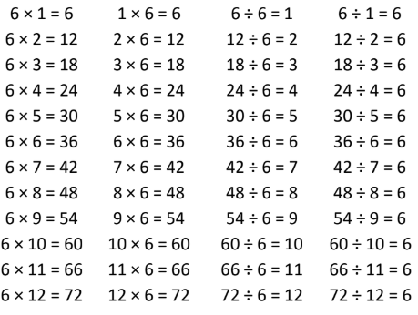
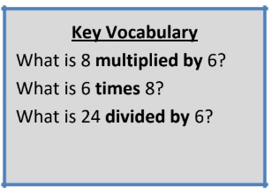
Year 4 – Term 2
I know the multiplication and division facts for the 6 times table.
By the end of this half term, children should know the following facts. The aim is for them to recall these facts instantly.
They should be able to answer these questions in any order, including missing number questions e.g. 6 × ⃝ = 72 or ⃝ ÷ 6 = 7.
Top Tips
The secret to success is practising little and often. Use time wisely. Can you practise these KIRFs while walking to school or during a car journey? You don’t need to practise them all at once: perhaps you could have a fact family of the day. If you would like more ideas, please speak to your child’s teacher.
Songs and Chants – You can buy Times Tables CDs or find multiplication songs and chants online. If your child creates their own song, this can make the times tables even more memorable.
Double your threes – Multiplying a number by 6 is the same as multiplying by 3 and then doubling the answer. 7 × 3 = 21 and double 21 is 42, so 7 × 6 = 42.
Buy one get three free – If your child knows one fact (e.g. 3 × 6 = 18), can they tell you the other three facts in the same fact family?
Warning! – When creating fact families, children sometimes get confused by the order of the numbers in the division number sentence. It is tempting to say that the biggest number goes first, but it is more helpful to say that the answer to the multiplication goes first, as this will help your child more in later years when they study fractions, decimals and algebra. E.g. 6 × 12 = 72. The answer to the multiplication is 72, so 72 ÷ 6 = 12 and 72 ÷ 12 = 6

Slide 3
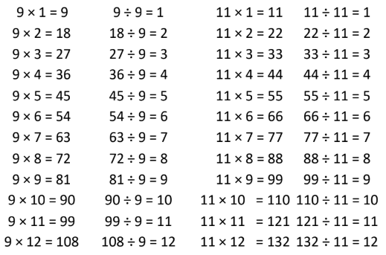
Year 4 – Term 3
I know the multiplication and division facts for the 9 and 11 times tables.
By the end of this half term, children should know the following facts. The aim is for them to recall these facts instantly.
They should be able to answer these questions in any order, including missing number questions e.g. 9 × ⃝ = 54 or ⃝ ÷ 9 = 11.
Top Tips
The secret to success is practising little and often. Use time wisely. Can you practise these KIRFs while walking to school or during a car journey? You don’t need to practise them all at once: perhaps you could have a fact family of the day. If you would like more ideas, please speak to your child’s teacher.
Look for patterns – These times tables are full of patterns for your child to find. How many can they spot?
Use your ten times table – Multiply a number by 10 and subtract the original number (e.g. 7 × 10 – 7 = 70 – 7 = 63). What do you notice? What happens if you add your original number instead?
(e.g. 7 × 10 + 7 = 70 + 7 = 77)
What do you already know? – Your child will already know many of these facts from the 2, 3, 4, 5, 6, 8 and 10 times tables. It might be worth practising these again!

Slide 4
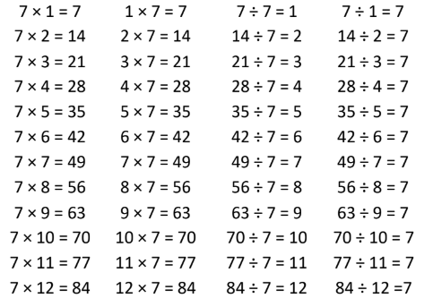
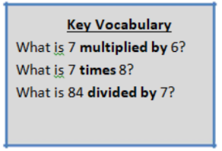
Year 4 – Term 4
I know the multiplication and division facts for the 7 times table.
By the end of this half term, children should know the following facts. The aim is for them to recall these facts instantly.
They should be able to answer these questions in any order, including missing number questions e.g. 7 × ⃝ = 28 or ⃝ ÷ 6 = 7.
Top Tips
The secret to success is practising little and often. Use time wisely. Can you practise these KIRFs while walking to school or during a car journey? You don’t need to practise them all at once: perhaps you could have a fact family of the day. If you would like more ideas, please speak to your child’s teacher.
Songs and Chants – You can buy Times Tables CDs or find multiplication songs and chants online. If your child creates their own song, this can make the times tables even more memorable.
Order of difficulty – Ask your child to order these facts from the easiest to the most challenging. Can they explain why some facts are easier to remember? Then focus on practising the most challenging facts.
Use memory tricks – For those hard-to-remember facts, www.multiplication.com has some strange picture stories to help children remember.

Slide 5
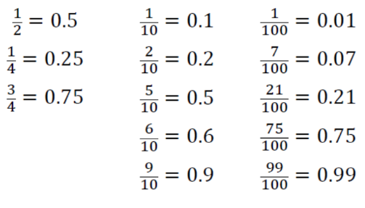
Year 4 – Term 5
I can recognise decimal equivalents of fractions.
By the end of this half term, children should know the following facts. The aim is for them to recall these facts instantly.
Children should be able to convert between decimals and fractions for 1⁄2, 1⁄4, 3⁄4 and any number of tenths and hundredths.
Top Tips
The secret to success is practising little and often. Use time wisely. Can you practise these KIRFs while walking to school or during a car journey? You don’t need to practise them all at once: start with tenths before moving on to hundredths. If you would like more ideas, please speak to your child’s teacher.
Play games - Make some cards with pairs of equivalent fractions and decimals. Use these to play the memory game or snap.
Or make your own dominoes with fractions on one side and decimals on the other.

Slide 6
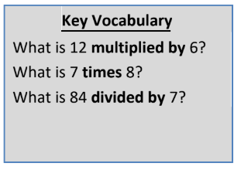
Year 4 – Term 6
I know the multiplication and division facts for all times tables
up to 12 × 12
By the end of this half term, children should know the following facts. The aim is for them to recall these facts instantly.
They should be able to answer these questions in any order, including missing number questions e.g. 7 × ⃝ = 28 or ⃝ ÷ 6 = 7.
Top Tips
The secret to success is practising little and often. Use time wisely. Can you practise these KIRFs while walking to school or during a car journey? You don’t need to practise them all at once: perhaps you could have a fact family of the day. If you would like more ideas, please speak to your child’s teacher.
Speed Challenge – Take two packs of playing cards and remove the kings. Turn over two cards and ask your child to multiply the numbers together (Ace = 1, Jack = 11, Queen = 12). How many questions can they answer correctly in 2 minutes? Practise regularly and see if they can beat their high score
Use memory tricks – For those hard-to-remember facts, www.multiplication.com has some strange picture stories to help children remember.

