Slide 2
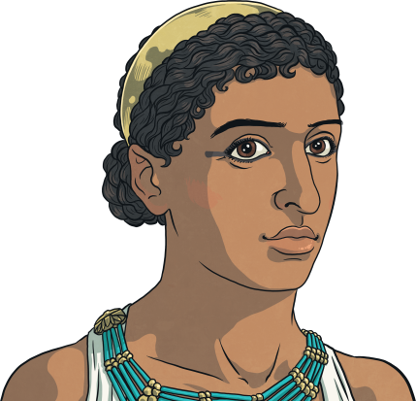
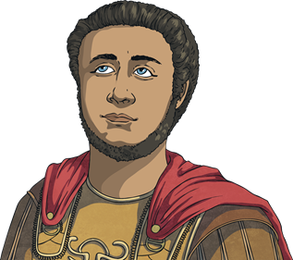
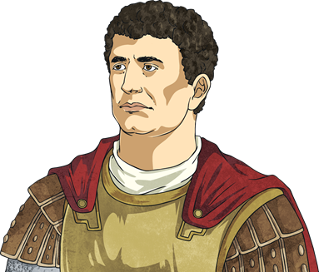
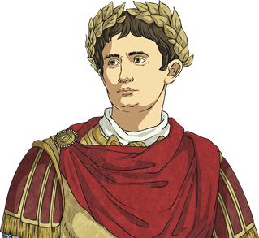
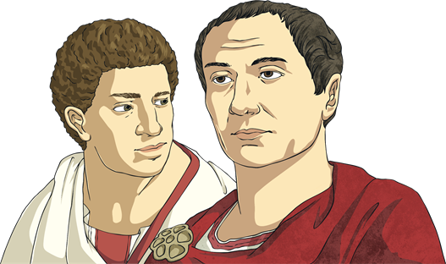
Who’s Who?
Cleopatra VII – co-regent of Egypt for nearly 30 years
Ptolemy XIII – younger brother of Cleopatra
Julius Caesar
– dictator of Rome
Mark Antony – general of Rome and friend and ally of Julius Caesar
Brutus and Cassius - politicians and generals of Rome
Octavian (later called Augustus) – ally and adopted son of Caesar, military leader
of Rome

Slide 3
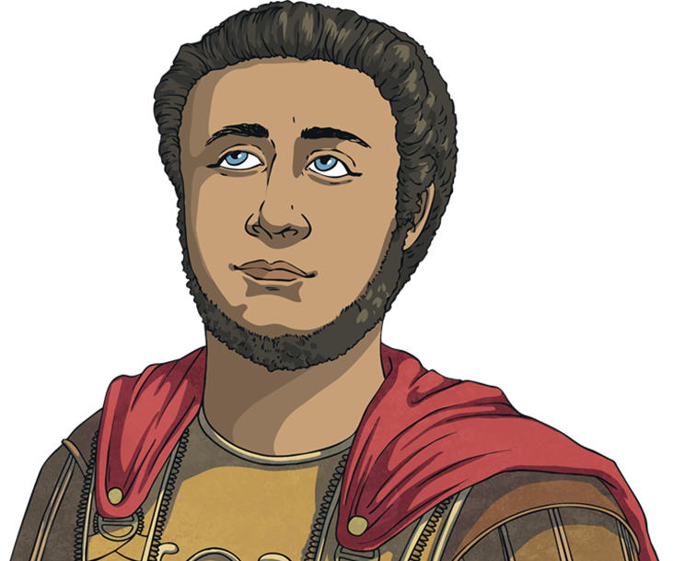
The Ptolemaic Dynasty
Cleopatra was born around 69BC. Her father was Ptolemy XII and ruled Egypt. When he died in 51BC, Cleopatra became co-regent of Egypt with her 10-year-old brother, Ptolemy XIII.
Not long after becoming co-regent, Cleopatra had to escape to Syria as her brother’s advisers threatened her life.

Slide 4
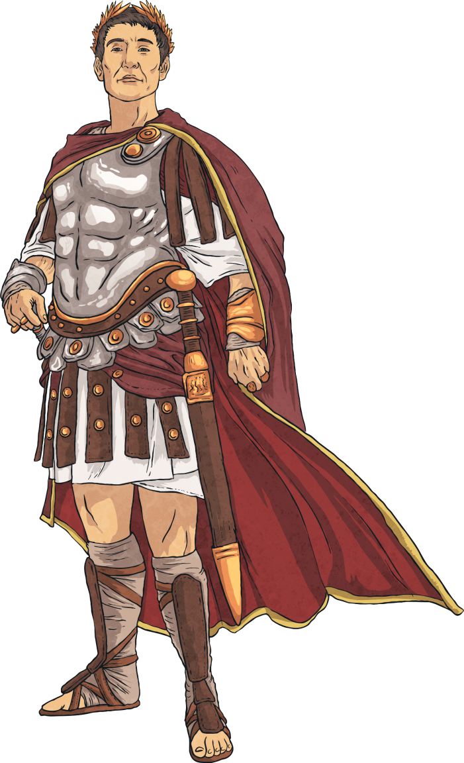
Julius Caesar
In 48BC, there was conflict developing between the leader of Rome, Julius Caesar and Pompey (a military and
political leader).
Pompey escaped to Alexandria, the capital city of Egypt. Ptolemy ordered Pompey to be killed by the Egyptian military.
Caesar arrived in
Alexandria. With help from
the Roman army, Cleopatra returned from exile in Syria
and was reinstated as queen.
The story goes that she was
smuggled into the palace
wrapped in a carpet, to
meet with Caesar.
Her brother, Ptolemy, was killed in battle and her other younger brother, 13-year-old Ptolemy XIV, was made the co-regent of Egypt.

Slide 5
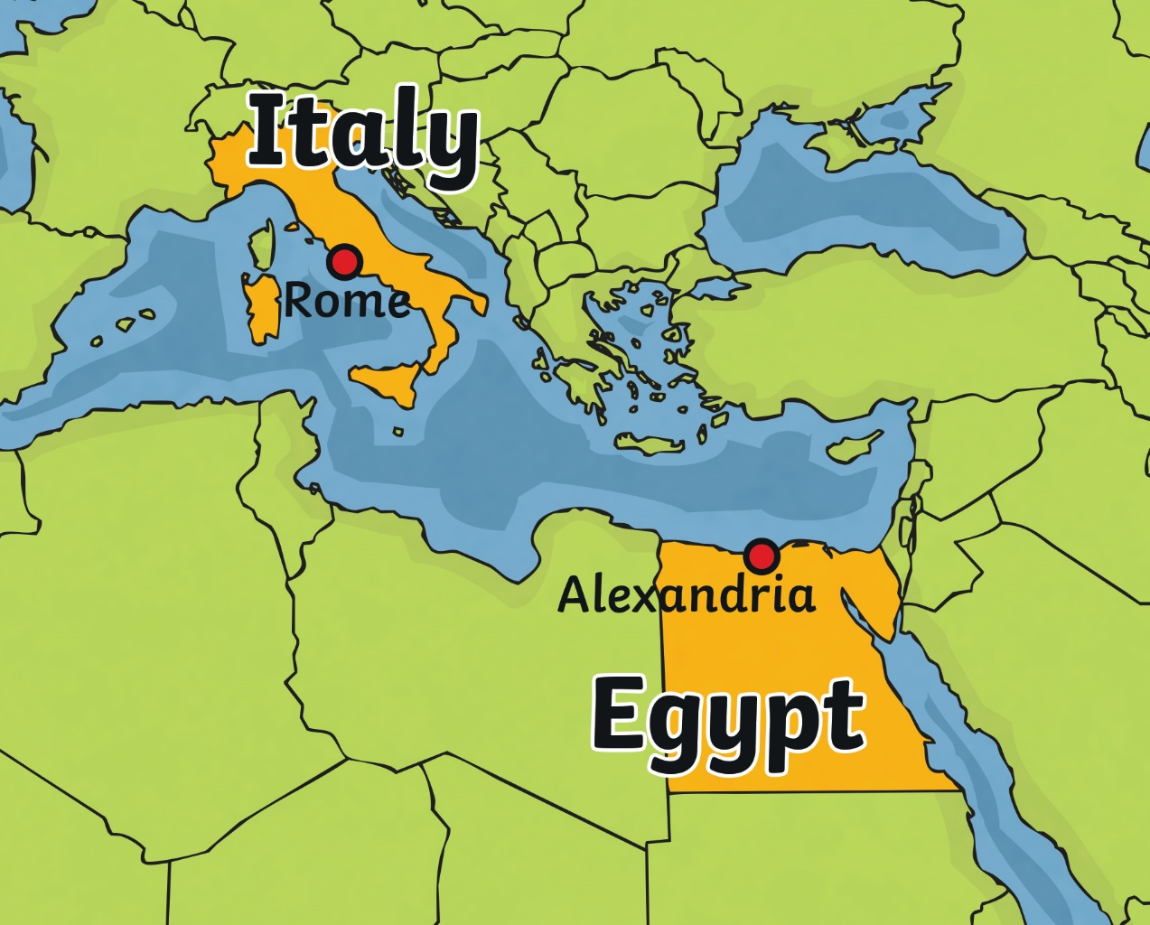
All Change
Caesar began a relationship with Cleopatra and in 47BC, she gave birth to his son, Caesarion, also referred to as Little Caesar.
After some time, Caesar left Egypt and returned to Rome. Cleopatra followed with her son but when Caesar was assassinated in 45BC, she returned to Egypt.
Around that time, Ptolemy XIV died in mysterious circumstances that meant Cleopatra could make her three-year-old son co-regent.

Slide 6
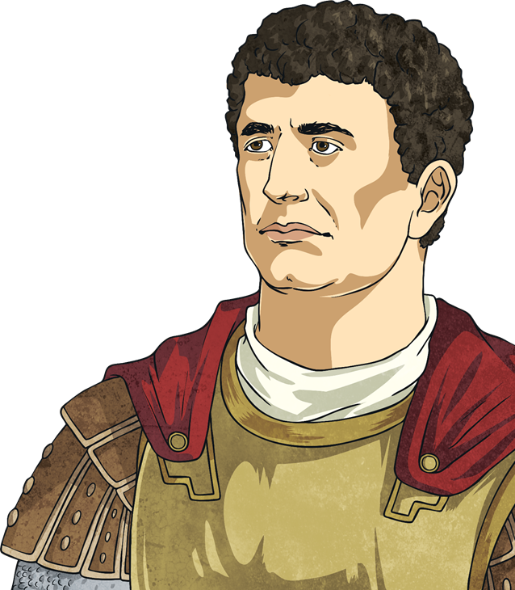
Mark Antony
In 41BC, there was conflict between Caesar’s allies, Mark Antony and Octavian, and the two men who murdered Caesar, Brutus and Cassius.
Both sides requested support from Egypt and eventually, Cleopatra sent an army to help Caesar's allies. Mark Antony and Octavian were victorious and divided the power in Rome between themselves.
Mark Antony requested a meeting with Cleopatra. According to a written source, she sailed on a golden barge with silver oars to the Turkish coast, dressed in robes like the goddess Isis, to meet him.

Slide 7
Cleopatra’s Children
Mark Antony was entranced by Cleopatra and he promised to support her. He returned to Egypt with her, leaving his family in Rome.
Cleopatra later gave birth to twins; Alexander Helios (meaning sun) and Cleopatra Selene (meaning moon).
They later had another son called Ptolemy Philadelphus.

Slide 8
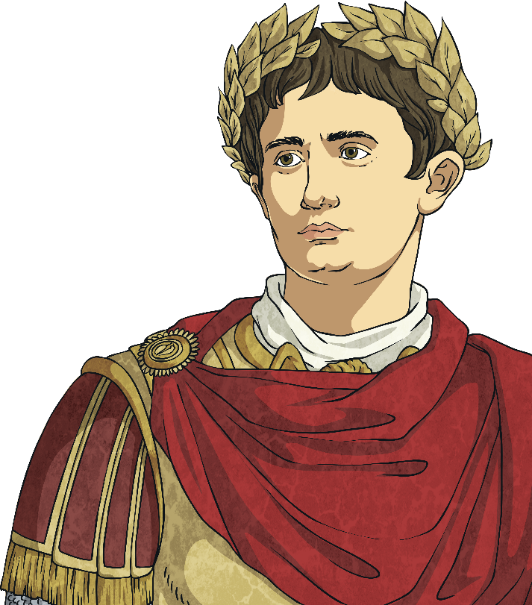
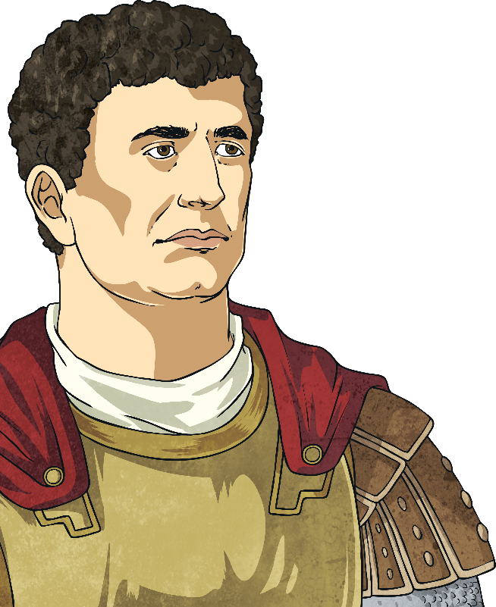
The End of an Era
In 31BC, a furious war began between Mark Antony and Octavian over the succession of Roman leadership.
Octavian’s army crushed Mark Antony’s in the Battle of Actium. Cleopatra escaped to Egypt and Mark Antony managed to follow. The city of Alexandria was under siege and Mark Antony heard a rumour that Cleopatra was dead. He fell on his sword and died.
On hearing this, Cleopatra locked herself in her chamber and ended her life. There are different theories about how she died but many say she allowed a poisonous snake to bite her.

Slide 9
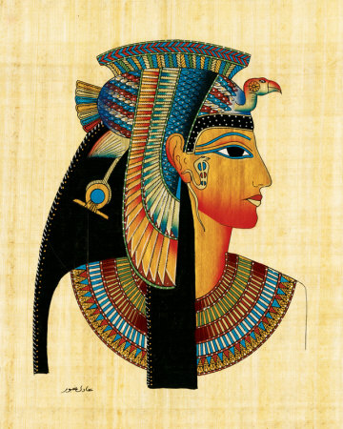
A Remarkable Woman
Cleopatra is known for her political awareness, power and rule during a time when all rulers were under threat of being overthrown or killed.
She was well educated in mathematics, philosophy and astronomy, and spoke a number of different languages.
She led a fleet of ships into battle, influenced two of the most powerful men of that time and ruled Egypt for thirty years, during one of the most turbulent periods in time in that region.
Photo courtesy of Eslam17 (@wikimedia.org) - granted under creative commons licence – attribution

