Slide 1






The Adventures of
Smartie the Penguin
Notes:
1
1

Slide 2




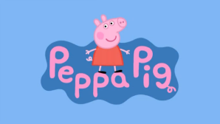












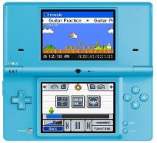
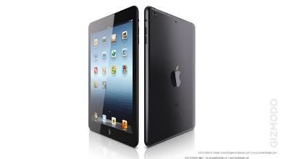


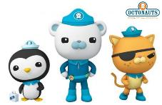
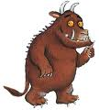

You might like…
Notes:
2

Slide 3
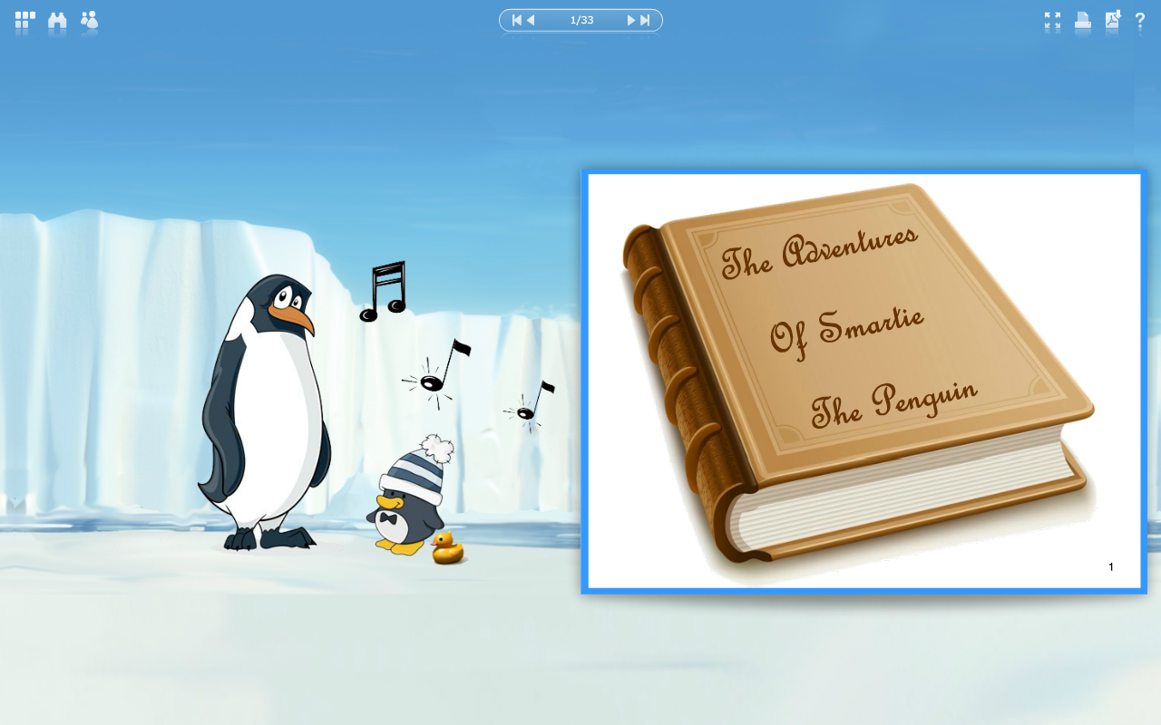




Notes:
3
3

Slide 4



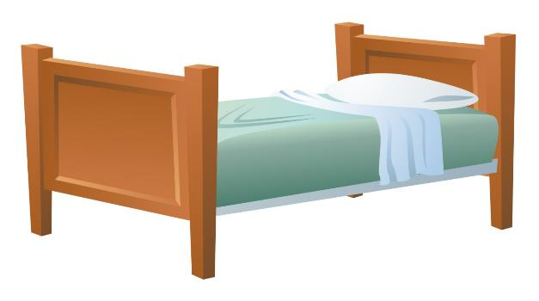




It was late at night and Smartie the penguin was WIDE awake… He was too excited to sleep because tomorrow was his birthday. He was really hoping to be given a new tablet!

Slide 5




The big day came and Smartie had really enjoyed his birthday party. He had saved his most exciting looking present until the end.
“Oh I really hope this is a tablet of my own!” he thought as he began to open it.

Slide 6
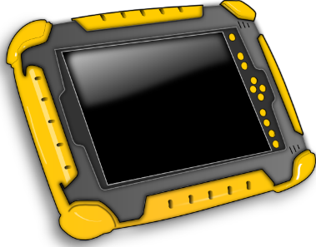



Smartie tore off the wrapping paper in a hurry! Mummy and Daddy Penguin had bought him a brand new tablet. Just what he wanted!
“Oh! Thank you, thank you, thank you!”

Slide 7





Smartie’s parents enjoy using the internet and are always there to help Smartie.
Smartie was allowed to play a game on his tablet once in the morning and once in the afternoon.
Mummy Penguin helped Smartie to find his favourite game and he was off!

Slide 8
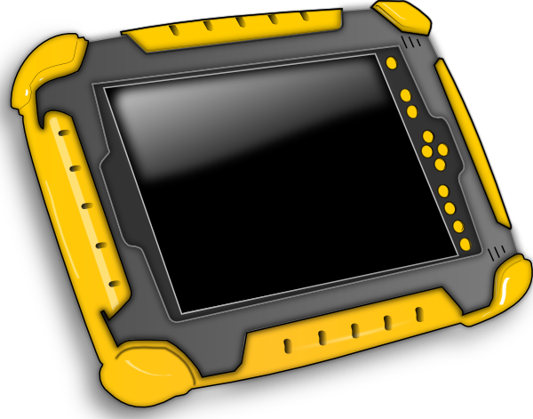


£
Everything was going well and Smartie was having a super time when all of a sudden… something very strange happened.
A picture popped up on to the screen. It was colourful and Smartie didn’t know what to do.

Slide 9



“Oh no!” thought Smartie. “Did I click the wrong buttons? Have I broken the tablet? Are mummy and daddy going to be cross with me?”
Oh no! What happened?
£

Slide 10





Can you help Smartie make the right decision?
Should he try to fix the problem by himself and get rid of the picture, or should he ask his parents for help?
Time to chat

Slide 11


HELP!!
“Help!” cried Smartie. “Daddy, mummy, please help me! Something has gone terribly wrong. There’s a funny picture on my screen and I don’t know where it came from.”

Slide 12

Well done Smartie!
“Well done Smartie,” said Daddy Penguin.
“What a CLEVER little penguin you are!
Well done for asking for help and not trying to fix it by yourself.”

Slide 13


Mummy Penguin was so pleased with what Smartie had done, she taught him a song to help him make sensible choices on the internet in the future…

Slide 14

Sing with me!
Before you tap and click…
You need to stop and think…
And TELL someone!

Slide 15
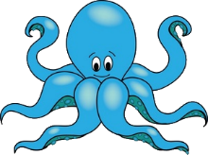





Mummy Penguin deleted the picture that had popped up and Smartie continued to play on his tablet.

