Slide 1
Chapter 5
A Chat With Old Wrinkly
and
Chapter 6 Meanwhile Deep in The Ocean

Slide 2
https://www.youtube.com/watch?v=SczEoPJrVbM
Read along – Chapters 5 and 6

Slide 3
5. A chat with old wrinkly – Focused Reading
Who is Old Wrinkly?
2. What is the one thing Hiccup has got and the tribe needs?
3. What does Old Wrinkly mean when he tells Hiccup that he is “going to have learn to be a hero the hard way”.
4. Why has Hiccup kept his hobby a secret?
5. What might be a better way to train a dragon.

Slide 4
6. Meanwhile, deep in the ocean…
1. How long has the sea dragon been asleep for.
2. Why has the sea dragon been asleep for so long?
3. What is happening now?
4. What do you think will happen next?

Slide 5
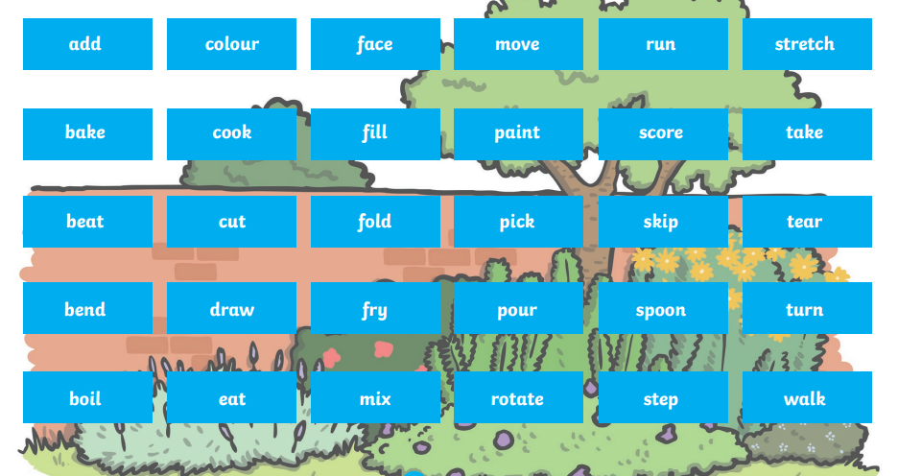
Don’t forget to use imperative verbs – you are giving someone a command!

Slide 6
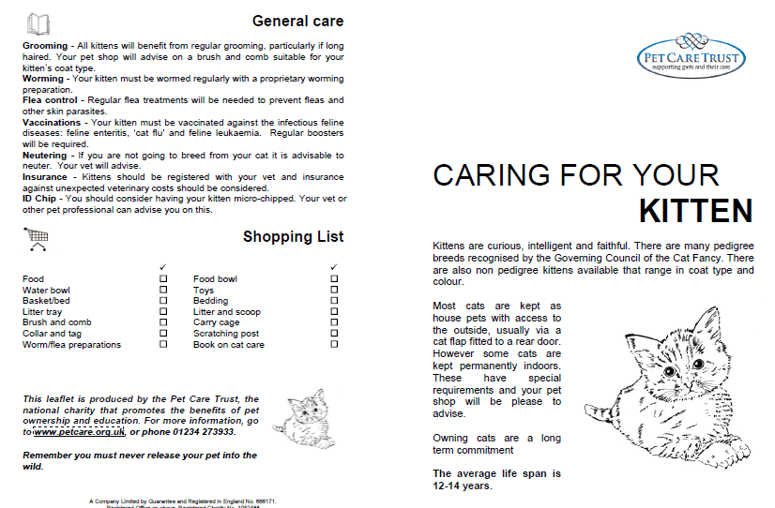
Today you are going to continue with your ‘How to Care for/Train a Dragon leaflet’

