Slide 1
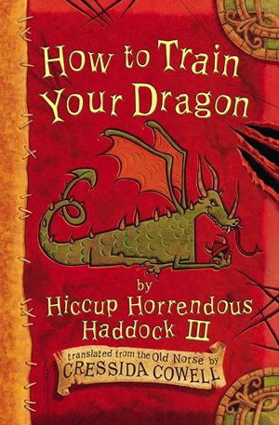
Chapter 4
How To Train your Dragon

Slide 2
https://www.youtube.com/watch?v=gDoD97bQgVg
Listen and read along to chapter 4

Slide 3
L4. How to train your dragon – Focused Reading
1. Why is Hiccup humiliated when he walks through the village?
2. What did Snotlout suggest Hiccup should call his dragon?
3. What is the ancient Viking Rule that Snoutlout has broken?
3. What is the name of the author of the book?
4. How much does the book cost?

Slide 4
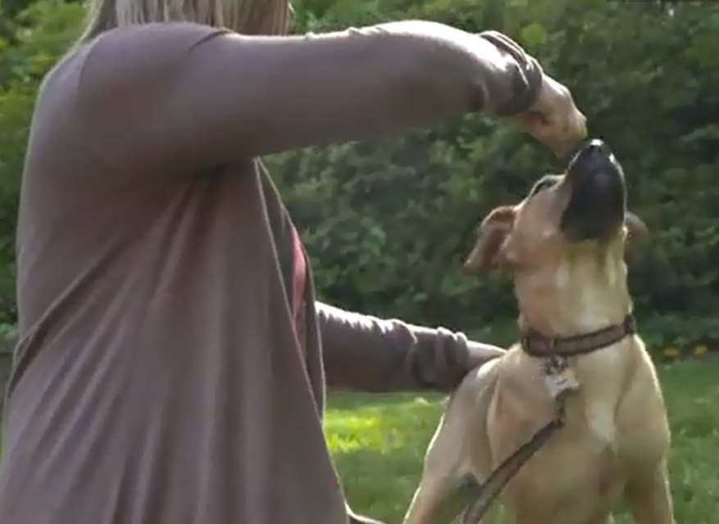
Will watching a guide to training a puppy help us improve the instructions
https://www.youtube.com/watch?v=DaG-y2tFBFE

Slide 5
How would you train a dragon?
Professor Yobbish’s one and only rule for dragon training is rather unhelpful.
Maybe if we thought about how we might train a dog to sit down or a kitten to use a litter tray it might help us.
What would you do?

Slide 6
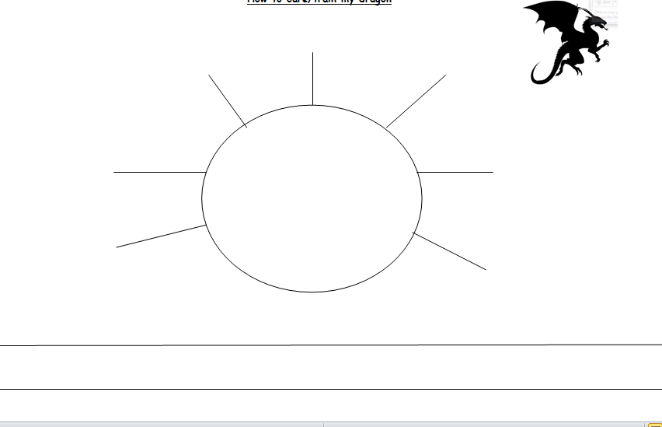

Slide 7
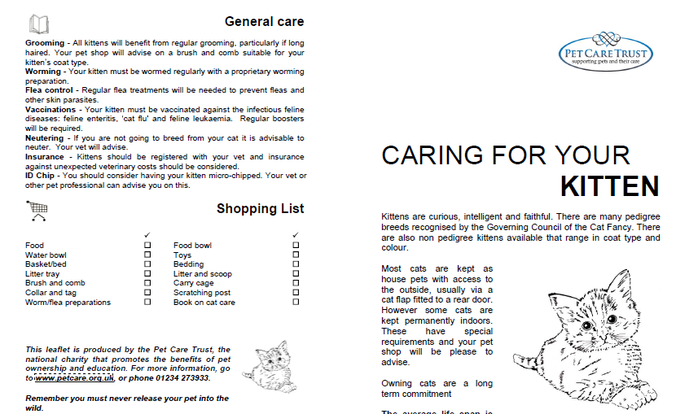
Make a ‘how to care for your dragon’ leaflet – brainstorm the information you might need to include

