Slide 1
Monday 1st March 2021
Can I make predictions based on clues in the text?
Can I order a set of instructions using imperative verbs and time connectives

Slide 2
A Note From Hiccup
&
Chapter 1
First Catch your Dragon
https://www.youtube.com/watch?v=oKiYuIsPxYk

Slide 3
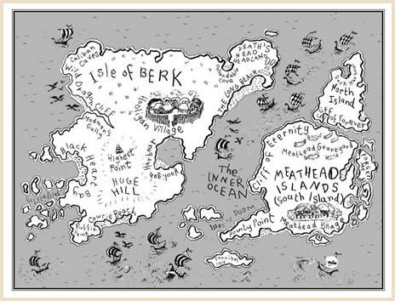
What does the map tell you?

Slide 4
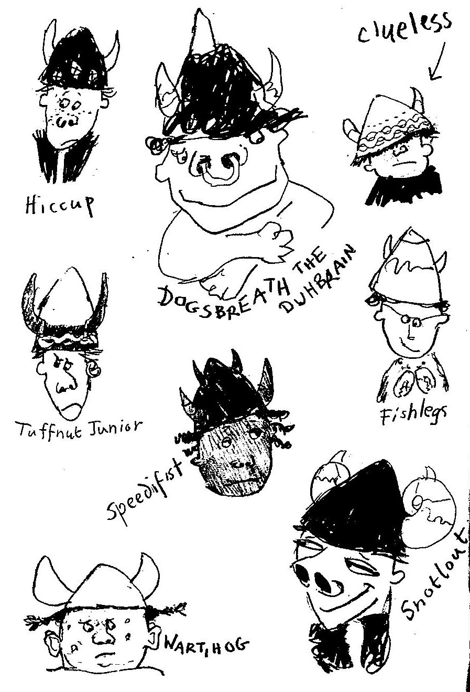
Looking at the characters here, can you make any predictions about the book?

Slide 5
https://www.youtube.com/watch?v=uWhNzQUfmSE Listen to part 1 as read by Cressida Cowell the author of the book.
You can read/follow along as she reads

Slide 6
Discussion questions A note from Hiccup
1. What do we know about Hiccup?
2. Is he a typical Viking?
3. Why?

Slide 7
1. First catch your dragon Focused Reading
1. How many boys were there?
2. What was the soldier in charge called?
3. How many parts are there to the D.I.T. test?
4. Why must Hiccup be in charge of leading the other boys?
5. What does Fishlegs have an allergy to?
6. What does exile mean?

Slide 8
Today we will be learning to order a set of instructions. But first let’s look at some imperative verbs. These verbs boss us about and tell us what to do!
hold
fetch
hide
open
sit
move
fold
pick
jump
get
stop
bring
shut
go
close
add
throw
put
catch

Slide 9
Take a look at these time connectives have a go at ordering them with your partner, you have two minutes
Finally
before
Then
Meanwhile
Firstly
After
Secondly
Thirdly
next

Slide 10
Re-write and order these instructions using imperative verbs
Next cover the pit with a brown sheet.
Finally place the large lump of meat on top.
In the end, the dragon will not be able to resist the temptation and will therefore fall into the pit.
First, dig a deep pit.
Now tiptoe behind a tree and wait.

