Slide 1
Monday 8th February 2021
New Setting – you have already chosen this setting last week
New Gift - cloak, hat, gloves, scarf (instead of a slipper)
New Creature – cat, eagle, camel (instead of a falcon)
Today you are going to draw your own comic strip of The Egyptian Cinderella but including the new pats that you have decided on. Most of the story remains the same!

Slide 2
Use this model to help you lay out your comic.

Slide 3
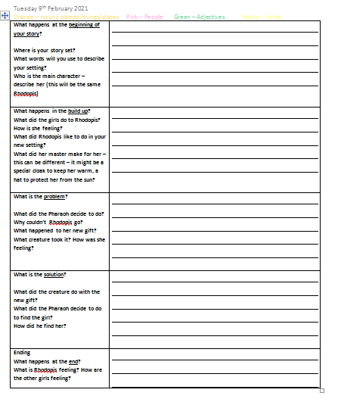
Tuesday 9th February 2021
Can I box up my own story?
Today, you are going to create your box it up plan which will help
you write your story tomorrow.
Use the comic strip pictures from yesterday and add
bullet points to the plan. Try to include the adjectives, show not
tell, similes that you will use in your story

Slide 4
Wednesday 10th February 2021
Build Up
Rhodopis spent her days using the fire to warm water, sweeping the floors and polishing the shiny, gold pictures that lined the walls. When she had finished all of her chores, she loved to bathe in the warm sunlight with her animal friends. In the heat of the midday sun, Rhodopis sit in her thick tunic that clung to her skin and large black boots.
One afternoon, while she was out playing with her friends, her master woke up from his nap and saw Rhodopis burning in the thick tunic and large, black boots.
“This isn’t fair!” He thought. “She really needs something more comfortable.”
Later that day, he had some dainty, blue sandals and a thin tunic that matched, made for her so that she could dance freely without feeling hot and sweaty.
Beginning
Long, long ago in the land of Egypt, where the sandy deserts stretch as far as the eye can see and the pyramids hide the gold throne rooms where the sun shines in all directions, there lived a girl named Rhodopis.
Rhodopis was stolen by pirates and sold as a slave when she was a baby. She lived with her master in a vast chamber filled with tall columns that reached as high as a mountain. They were covered with blue zigzag patterns that spiraled around the column. The sun shone brightly through the small round windows onto the cold, concrete floor.
The other Egyptian girls were jealous of Rhodopis and her beautiful green eyes that shone like emeralds. They taunted her and called her names.

Slide 5
Thursday 11th February 2021
Problem
Rhodopis loved her sandals and tunic so much, she spent most of her afternoons outside enjoying the warm sunshine on her skin.
One afternoon, as Rhodopis danced in the light, one of the Egyptian girls came running over waving an invitation in her hands.
“It’s from the Pharaoh! He is holding court for all of the fair maidens in Egypt!”
Rhodopis was suddenly overwhelmed with interest. She had never been out of the city walls and the thought of meeting a real Pharaoh was beyond belief.
“ You can’t come Rosy-Rhodopis!” They shouted. “ You have too many chores to do.”
Rhodopis watched as the other girls set off on the chariot out of city walls – a place where Rhodopis had never been! She turned and walked back inside the pyramid with her head hanging low and her arms feeling heavy by her side. As Rhodopis, reached the pyramid door, a bird dropped a worm from its beak and it landed on her beautiful, blue sandals. There it left a brown mark would stood out clearly on the fabric. Rhodopis bent down and took off the sandal. Just then, a gentle goat, took the sandal in his mouth and turned to run.
“Wait!” screamed Rhodopis. But it was too late. The goat had disappeared from sight.

Slide 6
Friday 12th February 2021
Ending
It was here where the Egyptian girls finally caught up with him. They were angry that he had left when they had arrived at his palace and had come home. They rushed over to him and held out their feet.
They suddenly reaslised that the sandal he was holding, belonged to Rhodopis (who was hiding and watching this through a window) but they said nothing.
It was at this point, that the Pharaoh looked up and caught a glimpse of Rhodopis; he beckoned for her to come out.
She walked slowly towards him and he handed her the sandal which fitted perfectly on her foot. Carefully, she took out the other sandal and the Pharaoh knew at once that he had found this queen!
Solution
The goat, in fact, was the ancient God, Horus. He had taken the sandal to the Pharaoh who was bored and wishing he was anywhere else but there.
Without warning, the sandal landed in his lap. At first, he was confused but as he looked up and saw the goat trotting away, he realised that this was a sign from the God, Horus. He knew, that the lady who the sandal belonged to was meant to be his queen.
He summoned his slaves at once and set off on his quest.
He journeyed across land and sea, through deserts and marshes but, in every place he stopped, the sandal would not fit onto any maiden’s foot.
Just as he was starting to give up hope, he found a small group of pyramids beyond the city wall.

