Slide 1
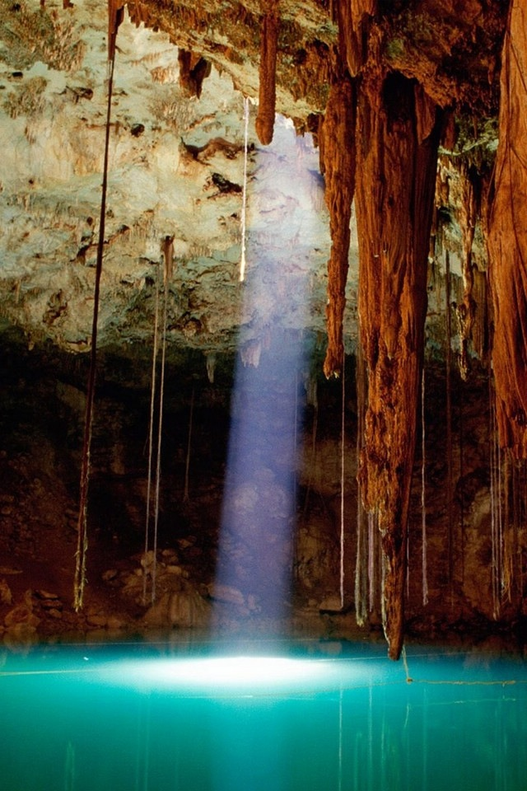
Monday 31st January 2021
Have a look at the following setting descriptions. How could you make them better? Think of ‘show not tell’ to make the setting descriptions better and to really give the reader a picture in their mind.
The cave smelt dirty. The water was blue and there was sun coming down. It was a bit scary.
The arch was covered in snow. It was cold. There was lots of ice and snow.

Slide 2
Tuesday 1st February 2021
Can I write an alternative setting description?
Today, you are going to look at alternative settings that you might use when you write your own Cinderella story next week.
Look at the different pictures and annotate them with your ideas. What can you see/hear/smell/feel? Use the sheet to help you organise your ideas. Use the range of adjectives we have looked at over the past couple of weeks to help you.

Slide 3
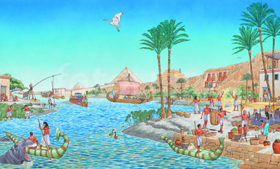
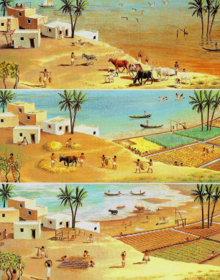
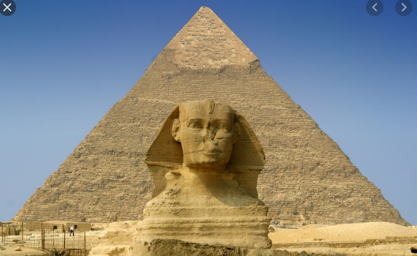
https://www.youtube.com/watch?v=NieC8KA0EvI – take notes on the setting shown in this clip. What different settings can you see?
Complete the sheet. What can you see, hear, feel, smell in these settings?

Slide 4
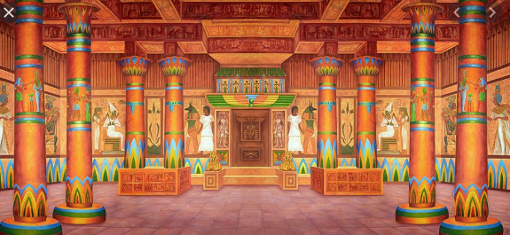
Wednesday 2nd February Today, you are going to choose one of the settings we looked at yesterday. The setting you choose will be where your story takes place next week. It will still be in Egypt but instead of taking place outside alongside the river Nile, it might take place on the river or in the desert or inside a pyramid.
Gold pillars line the hall. Colourful patterns circle them giving off different light as the sun shines on them.
Choose one of the pictures provided in your pack and create descriptive sentences you might use when describing this setting. Your picture will be in the middle of the page and around it we want to see your descriptive phrases

Slide 5
Thursday 3rd February 2021
Long ago, in the land of Egypt, where the tall, sandy pyramids stretched up into the sky and the heat from the sun burned the pathways, turning them to sand, there lived a maiden named Rhosopis. Rhodopis was stolen by pirates and sold as a slave. She now lived with her master in a pyramid in the desert. The pyramid was cool on the inside. It had small windows that let the warm air in and a round stone table where she prepared the dinner that stood the middle. At night, she slept on the cool sandy floor. She spent her days sweeping, cooking and collecting new straw for the floor.
Today you are going to write your own story beginning using your new setting
Beginning
Long ago, in the land of Egypt, where ………………………………………………………………………………………………………………………………………………………
There lived a maiden named Rhodopis, Rhodopis was stolen by pirates and sold as a slave. She now lived ………………………………………………………………………………………………………………………………………………………………………………………………………………………………………………………………………………………………………………She spent her days …………………………………………………………………………………………………………………………………………………………………………………………………………………………………………………………………………………………………………………………………………………………………………………………………………………………………………………………………….

Slide 6
Friday 4th February 2021
Start to think about your story – use the questions below to help you with your ideas. Remember your story will be in a different setting – it might be in a pyramid, in the desert, in the city, on a boat
Where does Rhodopis live in your story?
What does she lose?
Who/what takes it?
How does your story end?

Slide 7
Friday 4th February 2021

