Slide 2
Sorting
Talk About It
Imagine you had to sort these things into two groups. How would you decide on the groups? What would you call
each group?

Slide 3
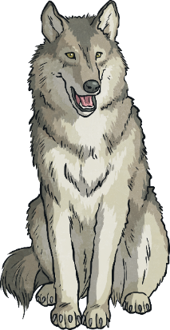
Sorting
plastic and non-plastic
green things and red things
living things and non-living things
edible things and non-edible things
animals and non-animals
There are lots of ways the objects could be grouped:

Slide 4
Sorting
Grouping the things would be useful if:
you wanted something to eat;
you needed to work out what things needed to be cared for.
Living things can be grouped. We call this classifying and each group is called a class. Classifying living things is called taxonomy and people who do this classifying are called taxonomists.
Talk About It
Why would putting the things into groups be useful?

Slide 5
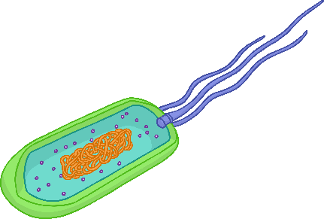
Classifying
Look at these living things. How could we classify them?
Killer whale
flower
lion
phytoplankton
ivy
virus

Slide 6
Classifying Animals
Animals can be classified into the following groups:
Mammals – whales, cows and humans are mammals;
Amphibians – toads and frogs are amphibians;
Reptiles – snakes, lizards and crocodiles are reptiles;
Fish – salmon, tuna and clownfish are fish;
Birds – owls, eagles and finches are birds;
Insects – caterpillars, beetles and ants are insects;
Crustaceans – crabs and lobsters are crustaceans;
Arthropods – many insects and crustaceans are arthropods;
Molluscs – octopus, squid and slugs are molluscs;
Arachnids – spiders are arachnids;
Annelids – earthworms and leeches are annelids.

Slide 7
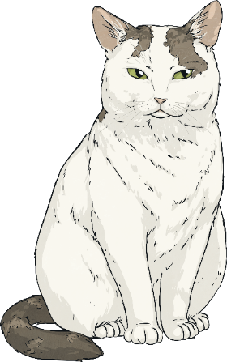
How Can We Classify Living Things?
Living things can be classified using a classification key like this one.
Does it have 4 legs?
yes
no
Does it have more than 4 legs?
yes
no
cat
Does it live on land?
Does it have feathers?
yes
no
yes
no
spider
lobster
owl
snail

Slide 8
Carl Linnaeus
In 1735, a scientist named Carl Linnaeus published ‘Systema Naturae’, which explained a way to classify living things.
Linnaeus put all living things into three groups called kingdoms; plants, animals and minerals. Each kingdom was then split into smaller levels. Scientists still use this system today. More species have been discovered since Linnaeus’ lifetime so extra categories have been added. The system now looks like this:
Domain
Kingdom
Phylum
Class
Order
Family
Genus
Species
Each level gets smaller until there is only one living thing in the species section.

Slide 9
The Linnaean System
Below is how a cat is classified using the Linnaean system.
Domain: | Eukarya
Kingdom: | Animalia
Phylum: | Chordata
Class: | Mammalia
Order: | Carnivora
Family: | Felidae
Genus: | Felis
Species: | Sivestris

