Slide 2
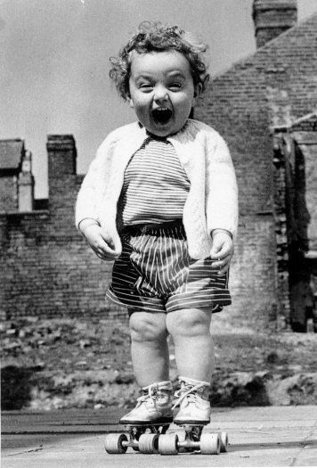
In today’s lesson we will learn…
Why it is important to have a healthy mind
How we can keep our minds healthy during periods of change

Slide 3
Feeling good
Words & phrases I will hear and use
Taking responsibility
Healthy lifestyle
Excited
Nervous
Healthy Mind
Feelings
Worried
Behaviour
Emotions
Choices & decisions
Support
Stressed
Balance

Slide 4
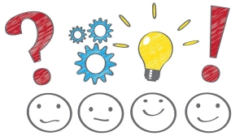
A ‘Healthy Mind’
What does having a ‘healthy mind’ mean?
We think positively
We can cope with school
We can deal with changes
We can cope with family life
We deal with our emotions & feelings
We have determination
We are resilient
We feel in control of our thoughts

Slide 5
A ‘Healthy Mind’
Discussion Question:
Talk to a partner about a time when you were nervous, felt stressed or unhappy – why was this?
What did you do to help you feel better?

Slide 6
A ‘Healthy Mind’
Discussion Question:
1. Talk to a partner about a time that you felt great & excited – why was this?

Slide 7
Understanding our minds
Things don’t always go smoothly
There will be times when things are tough or don’t go the way you would like them to
We need to know what we can do to help our minds at difficult times

Slide 8
Looking after our mind will help you…
Think clearly
Develop social skills
Learn new skills
Feel confident
Build your self-esteem
Have a positive outlook
Cope with different & new
situations

Slide 9
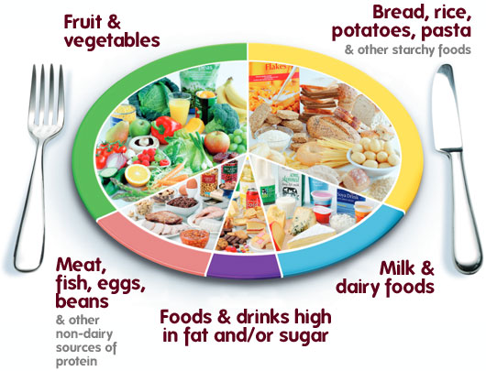
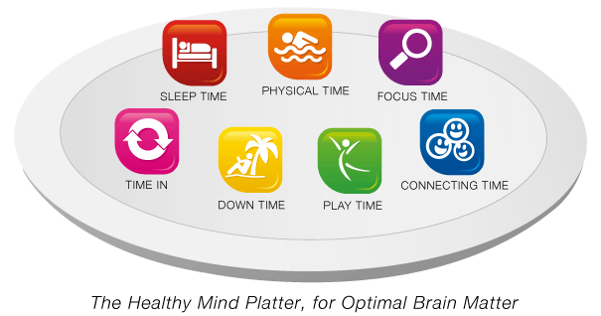
The ‘Healthy Mind Platter’
Just like the ‘Eatwell Plate’ for healthy eating
There is a ‘Healthy Mind Platter’ for a healthy mind

Slide 10
The Healthy Mind Platter has seven daily essential mental activities we need to have a healthy mind.
These seven daily activities make up the full set of “mental nutrients” that our brains need to function at their best.

Slide 11
Mix & Match Activity
Match up the following sentences with the correct Mental Activities from the Health Mind Platter
Focus Time
Play Time
Connecting Time
Physical Time
Time In
Down Time
Sleep
Time
Closely focus on tasks or taking on new challenges.
Reflect quietly on your day, week or thoughts in your head. Focus on any images, feelings and thoughts.
Be spontaneous and creative , playfully enjoying new experiences.
Letting your mind wander to recharge the brain. When you are non-focused, without any specific goal, and let your mind simply relax.
Rest to allow the brain time to recover from experiences of the day.
Actively moving your body by exercising, playing sports or going for a walk.
Connect with other people, seeing friends, enjoying family time or talking to people.

Slide 12
Mix & Match Activity - Answers
Focus Time Closely focus on tasks or taking on new challenges.
Play Time Be spontaneous and creative , playfully enjoying new experiences.
Connecting Time Connect with other people, seeing friends, enjoying family time or talking to people.

Slide 13
Mix & Match Activity - Answers
Physical Time Actively moving your body by exercising, playing sports or going for a walk.
Time In Reflect quietly on your day, week or thoughts in your head. Focus on any images, feelings and thoughts.
Down Time Letting your mind wander to recharge the brain. When you are non-focused, without any specific goal, and let your mind simply relax.
Sleep Time Rest to allow the brain time to recover from experiences of the day.

Slide 14
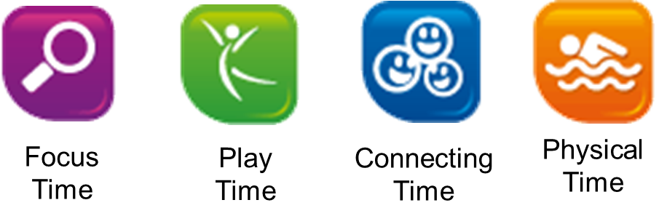
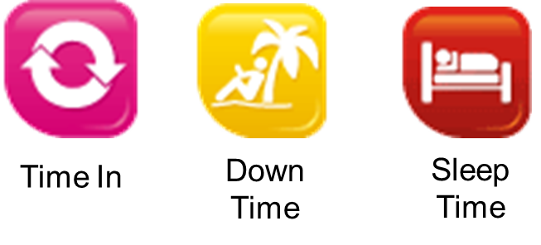
Daily Experiences to help our mind
Using the ‘healthy mind platter’ design your own action plan of activities that you are going to do to keep your mind healthy.
Share your action plans with a partner
Learn a new skill
Read a new book

Slide 15
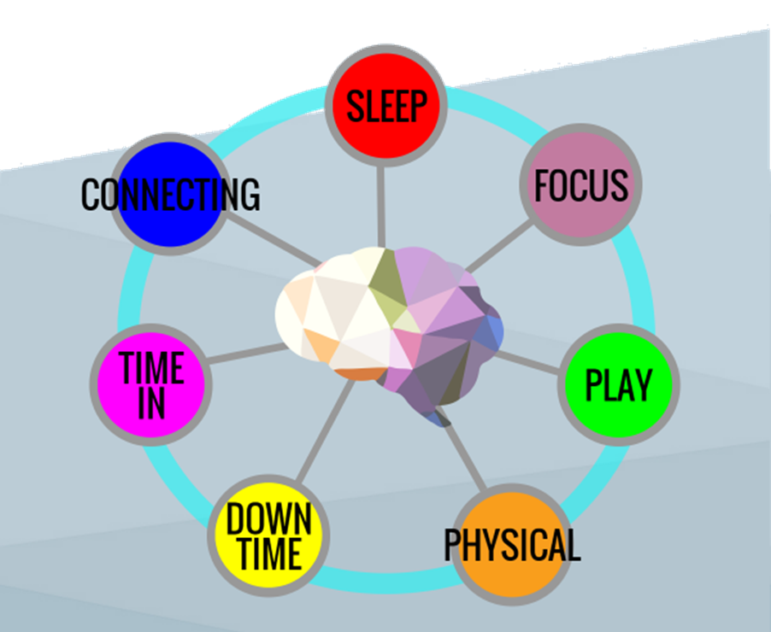
Daily Experiences to help our mind
What Healthy Mind activities are you going to do this week?
Top tip - If you plan & organise your week with some daily experiences to help your mind, you are more likely to succeed!

Slide 16
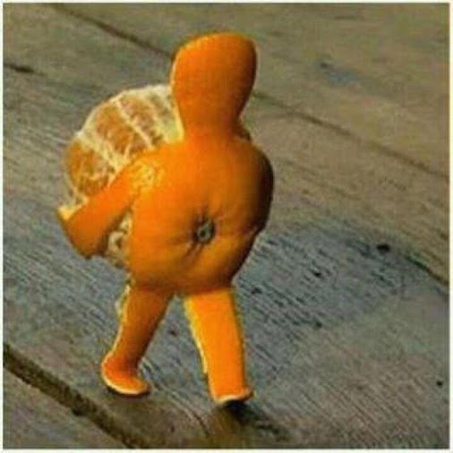
How will you need resilience to help you achieve a healthy mind?
Sometimes we have to pick ourselves up and each other up and carry on!

Slide 17
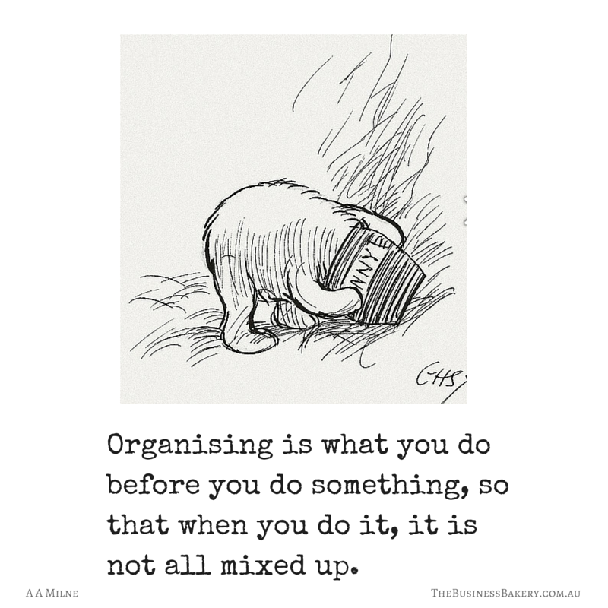
Why will you need Organisation to help you achieve a healthy mind?

