Slide 1



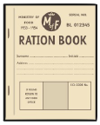


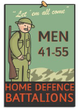



TOPIC: WW2
Imagine you are an evacuee. Write a postcard home to your family explaining what has happened to you.
Research rationing and write a menu using those ingredients.
Draw and explain what 6 things you would want to take with you if you were evacuated.
Make a newspaper report of a bombing on your street.
Design a poster persuading people to join the army.
Create a timeline of events that occurred in World War 2.
Find out the cost of rationed items. How much would you spend on a week’s food?
Write your name using Morse code. Could you construct a message?
Research what school life was like for children who were living during WW2.
Research what the blackout was and the effect it had on people/
Find out what the Enigma machine did and where it was based.
Find out where children were evacuated from and to in England. Show this on a map.
Find out the original meaning of the propaganda “Keep calm and carry on”.
Create your own model tank or gas mask.
Design a parachute for a soldier that would keep it safe.
Research WW2 propaganda posters. Make your own in their style.
Make an air raid shelter. / Anderson shelter. Think about which materials would be best to use.
Write a fictional diary as a child during WW2.
Research and write a short biography about a famous character from WW2 e.g. Winston Churchill.
Compare and contrast fashions of Wartime Britain and Britain today.
Create a graph comparing the size of armies from different nations.
Research a WW2 recipe and make it at home. Photograph the meal and write out the recipe. Write a review of the meal!
Write instructions or an advice leaflet for citizens to follow during an air raid.
Make your own WW2 word search.
Research Anne Frank and list 10 facts about her.
Draw and label a great airplane from WW2 e.g. British Supermarine Spitfire.
Play a game of battleships!

Slide 2
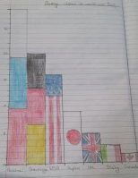
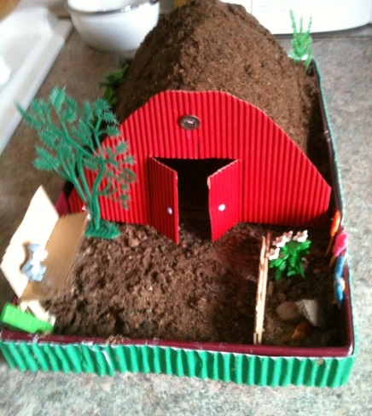
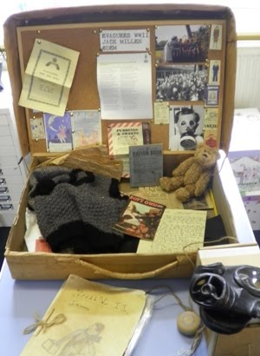
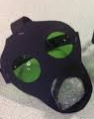
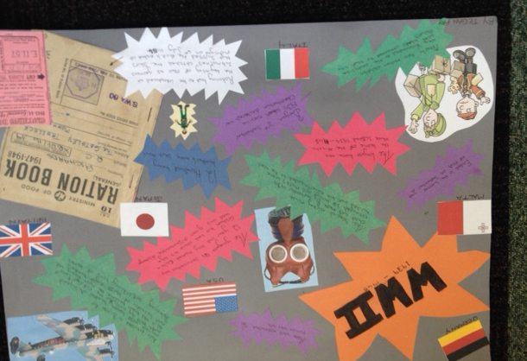
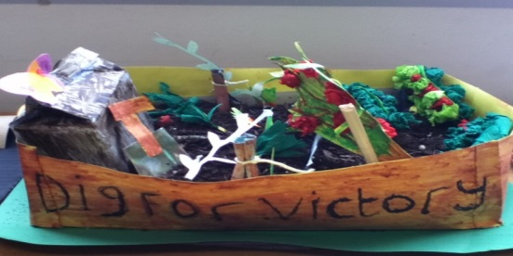
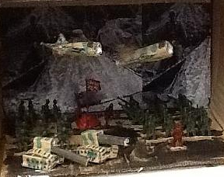
Write a script for a radio news broadcast about a key event during World War 2.
Draw a map of the world. Colour countries which were involved in WW2.
Read and review a war based book e.g. Friend or Foe, Goodnight Mr Tom, Carrie’s War, War Boy, An Elephant in the Garden, Kensuke’s Kingdom (all of these we have in school!)
Write a song to keep people's spirits up during the war.
Write in role as a soldier to his family about life in the trenches.
How has Britain changed since 1940? Find facts e.g. salary changes, house prices, wages.
Research how WW2 affected your local area.
Find out what ‘Dig for Victory’ was.
Research and present information about wars happening around the world today.
Research your family tree and find out which family members were alive in WW2. Can you find out anything else about them? Did any of them serve in the army?
Research & create fact file on key events e.g. Battle of Britain, the Blitz, VE day or D-Day.
Design & make a WW2 outfit.
Make a model 3D scene from the war.
Write a war based story / poem.
Visit a WW2 museum and write a diary / review about your trip e.g. Imperial War Museum, Canterbury Heritage Museum, Kent Battle of Britain Museum or the Spitfire and Hurricane Memorial Museum.

