Slide 1
Welcome to Beech
Mrs Starmer-Smith, Mrs Thorn and Mrs Reynolds

Slide 2
English
Reading each day is the most important thing children can do to support their learning.
A Homework book will be sent home and checked weekly. Children get entered into a raffle to win a prize when they’ve read at home.
Spelling, Punctuation and Grammar.

Slide 3
Maths
Year 4 maths will cover topics such as: Addition, Subtraction, Multiplication and Division.
We work with 3 and 4 digits.
Fractions and Decimals.
Shape and space.
Time and Money.

Slide 4
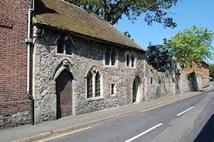
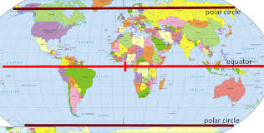
Topic
We will cover geography tasks- map reading and making, exploring our local area. We will discover how to plot various landmarks and countries.
Volcanoes will be studied.
We will find out about The Normans and the Ancient Egyptians.
School trips will connect to the topics.

Slide 5
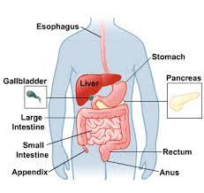
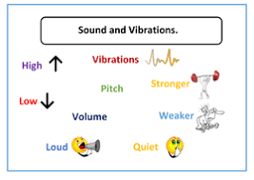
Science
We study Animals and their habitat
The digestive system
Sound
Electricity
And other topics.

Slide 6
Housekeeping
PE- Will happen every Thursday so please make sure to have kits in school.
Swimming lessons will start after Easter in Rye swimming pool.
Homework- Will be on the website.
Spellings will be given each week.

