Slide 1
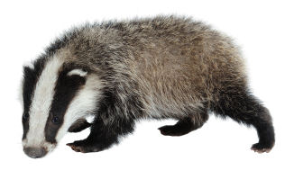
Welcome to Year 1
Miss Reynolds and Mr Warne – Otters
Miss Wilson and Miss Cox - Badgers

Slide 2
Topics this year
Term 1 – Toys
Term 2 – Jobs
Term 3 – Space
Term 4 – Dinosaurs
Term 5 – Buildings
Term 6 – Olympics with links to Food

Slide 3
Communication
Parent Mail
Purple contact books
https://www.st-nicholas-newromney.kent.sch.uk/the-curriculum/
https://teach.classdojo.com/#/launchpad

Slide 4
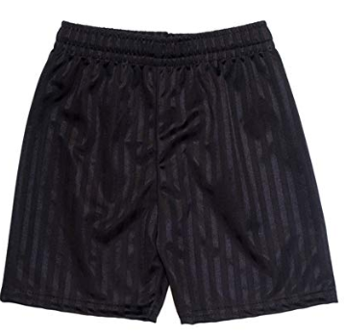
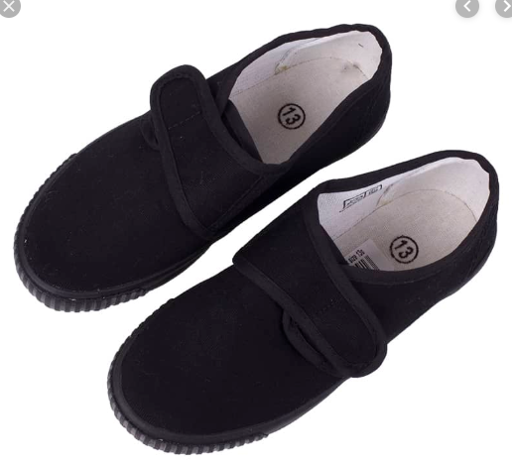
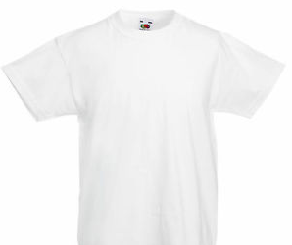
PE
Takes place on Wednesday
PE kit named and in a named bag
Earrings to be removed either by parent or child themselves.

Slide 5
Reading
10 minutes every night
Sign reading record
Buster’s Book Club

Slide 6
Key Dates
Term 1
Old School House – 8th October – TBC
Parents/Grandparents in to share toys – 15th October – TBC
Multi-skills at the Marsh Academy – 16th October
Term 2
Parents Evening – Thursday 14th November 3:30-8:00
Parents to talk about their jobs – Date TBC
KS1 Nativity Performances – Thurs 12th Dec @ 2pm and Fri 13th Dec @ 9:30am
Term 3
Astrodome workshop in school – 16th January
Assembly to Parents to share learning – Date TBC

Slide 7
Phonics Screening Check
Week beginning 8th June 2020
40 words – 20 alien and 20 real words
No time limit
Complete 1:1 with a year 1 teacher
Incorporates all sounds from RWI
Includes multi-syllable words

