Slide 1


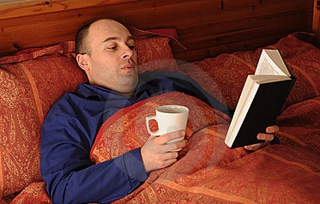


Where do you read?

Slide 2



When do you read?
Remember you are a role-model for your child!

Slide 3
Why phonics?
Gobblefunk whizzpopping bopmuggered swogswallowed snozzcumber frothbuggling

Slide 4
Phonics teaching
Revise sounds we know
Learn a new sound
Read a new sound
Practise it
Use it in writing

Slide 5
Phonics Screening
What does it look like?

Slide 6
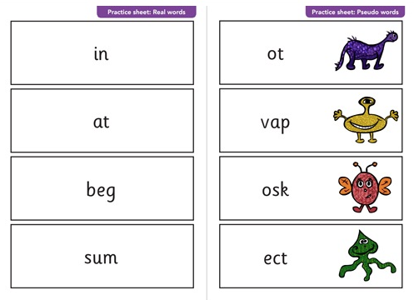

Slide 7
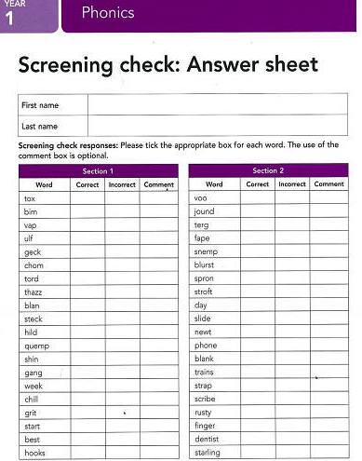

Slide 8
Phonics Screening
When: Early June
Where: In school
With whom: Miss Common and Miss Reynolds
How do I know if they’ve passed: Letter to parents early July

Slide 9
Phonics Screening
What happens if they don’t pass?

Slide 10
Helping your child at home..
Read with your child every day
Practise the sounds every day
Look for sounds in their books or on signs
Use website games

Slide 11
Helping your to help your child
https://www.oxfordowl.co.uk/for-home/reading-owl/expert-help/phonics-made-easy#audio
Videos to help adults say the sounds correctly and information about phonics screening
www.bbc.co.uk/schools/ks1bitesize/literacy/
a very good selection of interactive games focussing on phonics and sentence construction. Each is split into medium/hard/really hard and are short and fun.
www.ictgames.com/literacy.html
a great selection of games that link well with games in Letters and Sounds.
www.phonicsplay.co.uk
a selection of interactive games for all phonic phases. Mostly simple games.
www.bbc.co.uk/schools/wordsandpictures/phonics/
mix of very good interactive games and worksheets covering most phonic phases. Recommend Sandcastle quiz for phase 3 and 5.

Slide 12
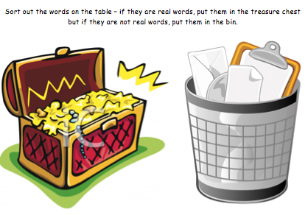
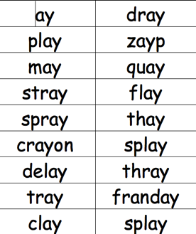
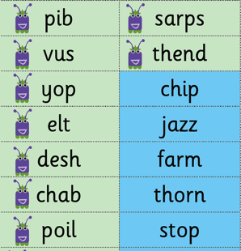
Helping your to help your child
Chest / Bin sorting
Bins from the Works
Snap
Print two sets and play pairs

Slide 13
Any Questions?

