Slide 1
Read Write Inc. Phonics Parents’ Meeting
Notes:
Notes are provided to help you lead the presentation.
Notes in italics are for your attention only.

Slide 2
Teach a child to read
and keep that child reading [and talking]
and we will change everything.
And I mean everything.
Jeanette Winterson
Notes:
This is what we do in our school.
Read quote.
We want our children to learn to read as quickly as possible and then to keep on reading – to read widely and often and be a lifelong reader.
We have added ‘and talking’ because it is central to everything we do in our school.
Research shows that children who learn to read quickly go on to succeed in school and in life.

Slide 3
What is Read Write Inc. Phonics?
Notes:
Read question.

Slide 4
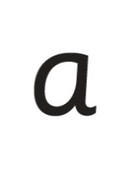
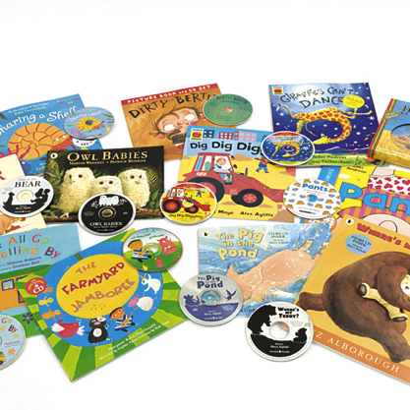
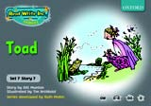
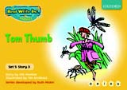
Systematic approach
sat
mat
p
d
sad
i
t
n
Notes:
Read Write Inc. Phonics is a programme that uses systematic phonics to teach all children to read.
It lasts two years for most children - if they start to learn to read in the Reception class.
(There are some children with learning difficulties who spend longer on the programme.)
Click – We teach the sounds first – in a specific order.
Click – We then teach your children to blend those sounds together in order to read words
Click – The children read words in the matched Storybooks. Each Storybook is carefully matched to the sounds they can already read - setting them up for success.
Click – We read to children ‘real’ books’. Once they have learnt to read, they will be able to independently read these books for themselves.

Slide 5
What is systematic phonics?
Notes:
Read question.

Slide 6
Phonics
Sounds
Graphemes
Notes:
The English language is very complex.
Phonics is the method of teaching reading through the identification of sounds and graphemes.
Click. All words are made up of sounds e.g. in ‘mat’ we have the sounds ‘m’, ‘a’, ‘t’.
Click A grapheme is another name for the letters we use to write the sound. Write the letters ‘m’ ‘a’ ‘t’ in the air as you say the sounds.
We teach phonics so that your children will have the tools to read any word.

Slide 7
Pure Sounds
Notes:
We teach using pure sounds.
We use pure sounds (‘m’ not’ muh’, ’s’ not ‘suh’, etc.) so that your child will be able to blend the sounds into words more easily.
Children need to know sounds – not letter names – to read words.
This video of Sylvie – available on the website – demonstrates how to talk in pure sounds. Play video.

Slide 8
English alphabetic code
44 sounds
Over 150+ graphemes
One of the most complex alphabetic codes in the world.
Notes:
In English we have more than 150 ways to represent 44 sounds, using the 26 letters in the alphabet.
This means we have to group letters together to write some sounds. Show with a grapheme such as ‘igh’.
This makes our language one of the most complex in the world!

Slide 9
Speed Sounds chart
Notes:
We use this Speed Sounds chart in Phonics lessons.
It shows the most common graphemes for each sound.
Each box is a sound box showing different ways to read and write the sound. Demo the ‘f’ sound box with examples of words ‘fun’, ‘huff’, ‘photo’ and the ‘or’ sound box with examples of words ‘or’, ‘door’, ‘more’, ‘dawn’, ‘author’.

Slide 10
How does Read Write Inc. use phonics to teach reading?
Notes:
Read question.

Slide 11
Simple Speed Sounds
Notes:
Phonics makes learning to read easy for children because we start by teaching them just one way of reading and writing every sound. Here they are on the Simple Speed Sounds chart.
We teach Set 1 sounds first - (sounds as far as a e i o u) and then Set 2 (the shaded sounds ay - oy).
Use MTYT to teach each of the pure sounds to parents.

Slide 12
Blending using Fred Talk
p
sat
d
mat
i
t
sad
n
Notes:
Once the children know the pure sounds, we teach them to blend sounds to read words. We also teach children to spell the words they learn to read.
We use Fred Talk to help children read and spell words.

Slide 13
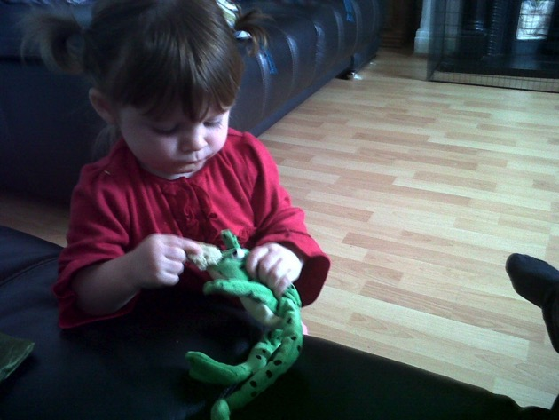
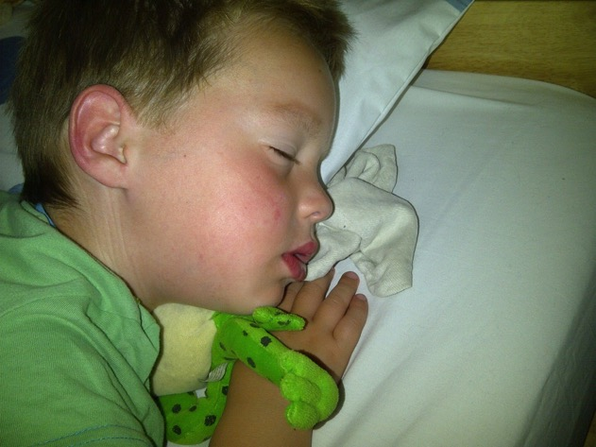
Fred Talk
Notes:
This is Fred.
He is a frog who can only speak in sounds, and we call this Fred Talk. For example ‘m’ ‘a’ ‘t’, ‘l’ ‘u’ ‘n’ ‘c’ ‘h’.
He helps children sound out words so they can read and spell.
MTYT some examples with the parents. For example ‘m’ ‘a’ ‘t’ mat, ‘s’ ‘a’ ‘t’ sat.
Click. Fred is our friend!

Slide 14
Complex Speed Sounds chart
Notes:
Once they can Fred Talk and blend sounds into words from the simple chart, we teach them Set 3 sounds on the complex chart – the other ways of reading and writing each sound so that they can soon read anything.

Slide 15
Storybooks
Notes:
Alongside learning each set of sounds, they read Storybooks that only contain the sounds and words they can read. This sets them up to succeed in their reading.
We discuss and write about the ideas in these Storybooks.
We also teach children to read common exception words – words like ‘said’ and ‘they’.

Slide 16
How does Read Write Inc. teach spelling?
Notes:
Read question.

Slide 17
Fred Fingers
Notes:
We use Fred Fingers to help children sound out words to spell easily.
It means they do not have to memorise lists of spelling words.
It is a tool so they will be able to spell any word.
Demonstrate how to use Fred Fingers.

Slide 18
What should my child read at home?
Notes:
Read question.

Slide 19
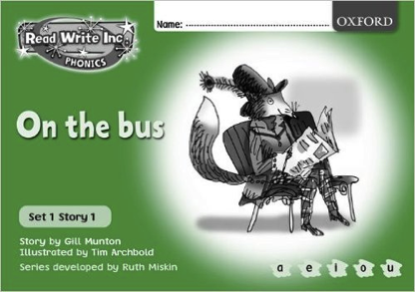
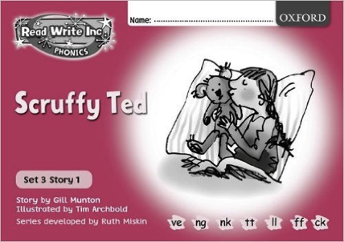
Read Write Inc. Storybooks
Notes:
Storybooks/ black and white paper versions of the Storybooks will be sent home for your children to read.
They will know all of the sounds used in the Storybook as they will bring home the book that they have already read three times in the classroom.
This means they will be able to read the text with fluency and confidence – like a storyteller. They will enjoy reading to you.
This does not mean the text is too easy for them – it means they are reading at the correct level.
We do not send texts home the children cannot read because we always want them to be set up to succeed in their reading.

Slide 20
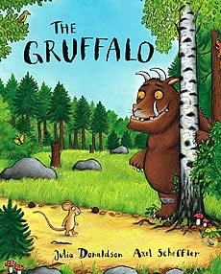
Picture books
Notes:
If you have picture books at home, read these and discuss them with your children, or go to the library in new romney too!

Slide 21
How can I help at home?
Notes:
Read question.

Slide 22
Storytime
Read to your children
Ask lots of questions and share opinions
You're never too old, too wacky, too wild, to pick up a book and read to a child.
Dr Seuss
Notes:
One of the most important things you can do as a parent at home is read higher level texts to your child.
This helps develop an enjoyment for stories and the motivation for learning to read themselves.
Ask questions and share opinions about what you read to engage them in discussion, get them thinking about what they read and develop vocabulary.
Click and read.

Slide 23
Talking
Talk to your child as much as possible and ‘feed’ them new and ambitious vocabulary.
“Let’s eat our lunch now.”
“Let’s munch our lunch now.”
“Let’s scoff our lunch now.”
“Let’s devour our lunch now!”
You’re looking ... not just... but...
Notes:
Click through and read examples to parents.
Use ambitious vocabulary with your children and encourage them to use these words for themselves in both their speech and writing. Build interesting sentences with your child.
A rich vocabulary is essential for high levels of comprehension. The more words your child has in his/her head when they come to school, the quicker they will understand when they read, e.g.
“You’re looking pleased… not just pleased but delighted!” (thrilled/ecstatic/euphoric! Etc)

Slide 24
Vocabulary
Enrich conversations through description:
“Look at that rain. It looks like little diamonds sparkling on the window pane!”
Have fun with words and language.
“I’m as hot as a spud in a cooking pot!”
Praise your child for using new words or interesting phrases
Notes:
Help grow your child’s vocabulary by enriching conversations through description.
Click and read examples.
Give other examples if you want to.

Slide 25
Read Write Inc. lessons
Support how your child is learning to read and spell in school.
Pure sounds
Fred Talk
Fred Fingers
Notes:
It really helps to be aware of how your child is learning in the classroom – pure sounds not letter names; Fred Talk when they are reading words and Fred Fingers when they are spelling words.
Encourage your child to discuss their Phonics lessons with you and to read and discuss their storybook with you at home.
We have shared the basics of Read Write Inc. Phonics and how you can help.
There are also some online resources that you can access for free. Click through to next slide.

Slide 26
Online resources available
Ruth Miskin Parents’ Page:
http://www.ruthmiskin.com/en/parents/
Ruth Miskin Facebook:
https://www.facebook.com/miskin.education
Free e-books for home reading:
http://www.oxfordowl.co.uk/Reading/

Slide 27
Any other questions

Slide 28
St Nicholas CE Primary Academy
Phonics Packs
Oxford Reading Owl website
Expectations
We expect you to read every evening with your child 5-10 minutes.

Slide 29
St Nicholas CE Primary Academy
Reading feeds the imagination, it expands
horizons and offers new and exciting ways of
seeing and making sense of our lives and of
the world around us.
Michael Morpurgo

