Slide 1
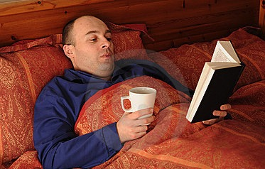
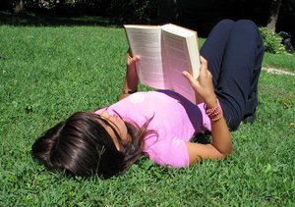
Where do you read?

Slide 2
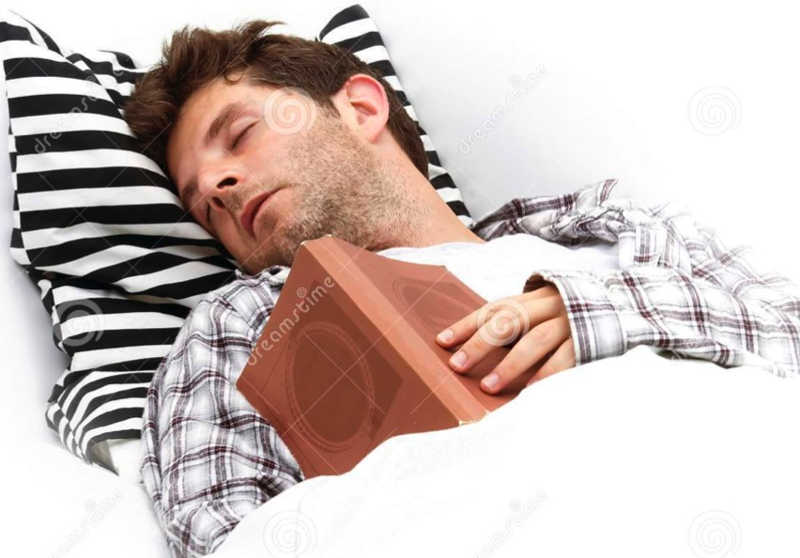
When do you read?
Remember you are a role-model for your child!

Slide 3
Phonics Screening Reading at St Nic’s
With Miss Common and Yr1 pupils

Slide 4
Why phonics? Gobblefunk whizzpopping bopmuggered swogswallowed snozzcumber frothbuggling
With Miss Common and Yr1 pupils

Slide 5
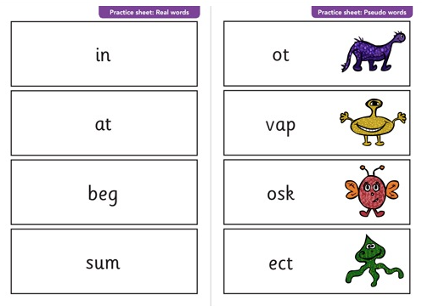

Slide 6
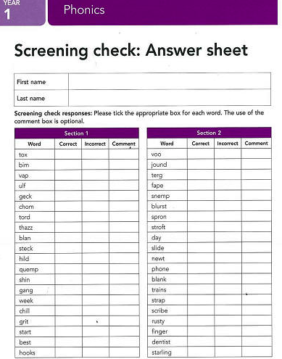

Slide 7
Phonics Screening
With Miss Common and Yr1 pupils

Slide 8
Phonics teaching
Revise sounds we know
Learn a new sound
Read a new sound
Practise it
Use it in writing

Slide 9
Helping your child at home..
Read with your child every day
Practise the sounds every day
Look for sounds in their books or on signs
Use website games
Record all types of reading
Help writing sounds

Slide 10
Helping your child at home..

Slide 11
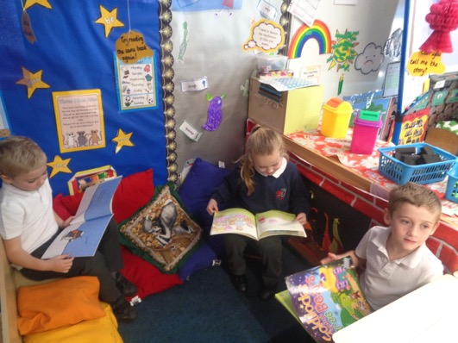
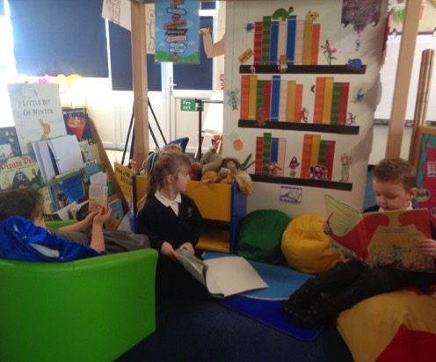
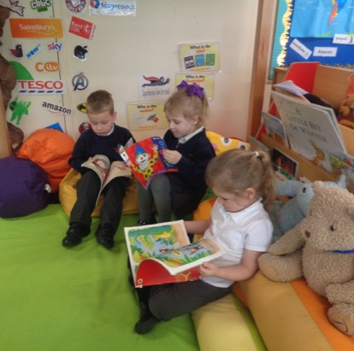
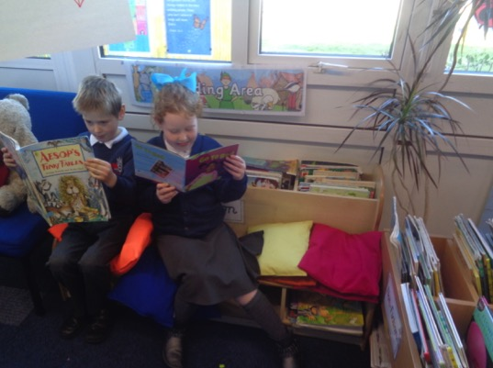
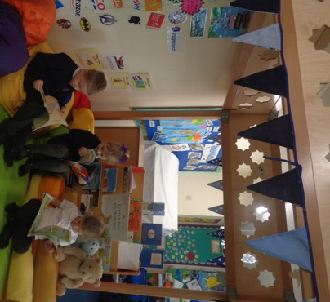
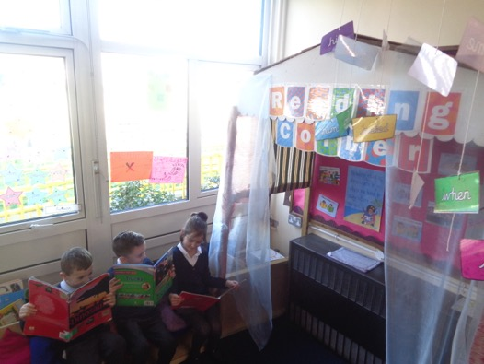
Book Corners

Slide 12
Incentives to read!

Slide 13
Any Questions?

