Slide 1
Welcome to the Year 3 and 4 English Curriculum
The most important
subject of them all.
Curriculum elements
Handwriting
Individual Reading
Guided Reading
SPAG
Clued Spelling
Comprehension
Power of Reading
Pie Corbett

Slide 2
Handwriting
This is taught formally twice a week.
Without legible handwriting it is hard to communicate ideas and understanding.
Children should have a fluent, legible style by the end of Year 4.

Slide 3


Handwriting Year 4
Taught in 10 minute daily sessions.
Clear rules
Increase fluency
Develop correct letter formation
Ensure cursive joins are used

Slide 4
Individual Reading
Each child has a reading book that goes to and from school daily.
This book is read in school regularly and for homework daily too.
On Thursday morning a note of the minutes read on Wednesday is recorded for Buster’s Book Club.

Slide 5
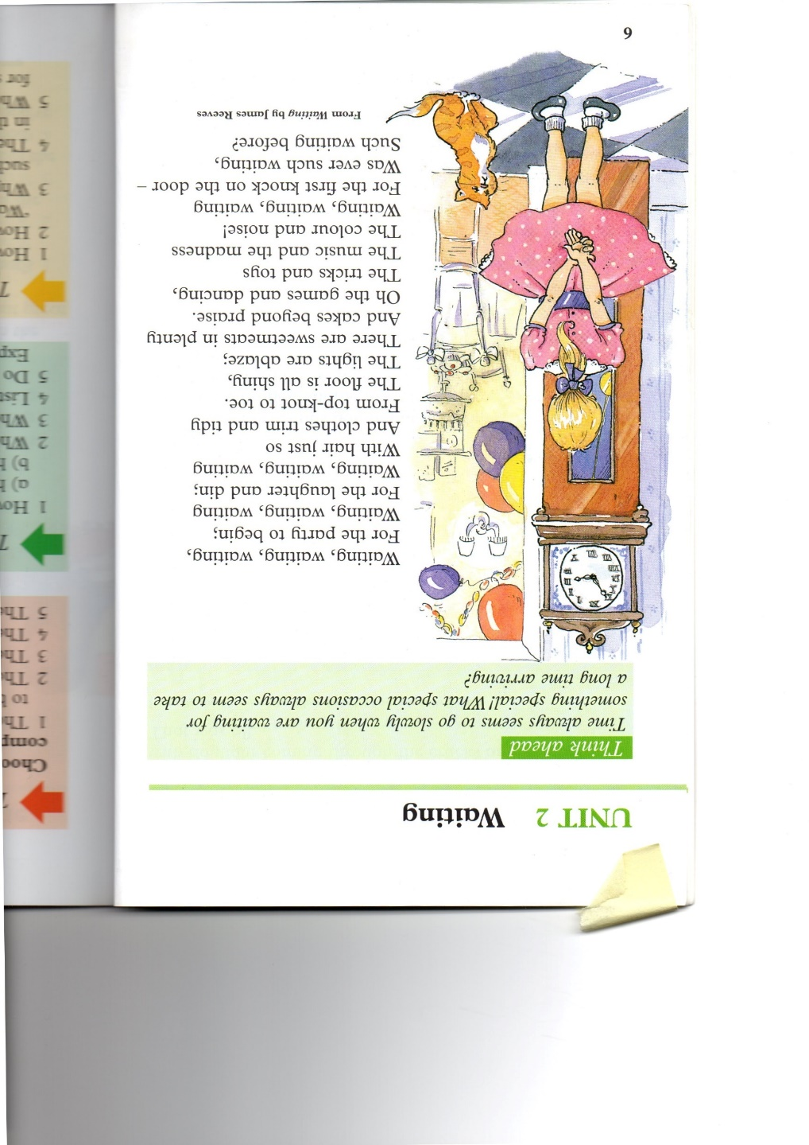
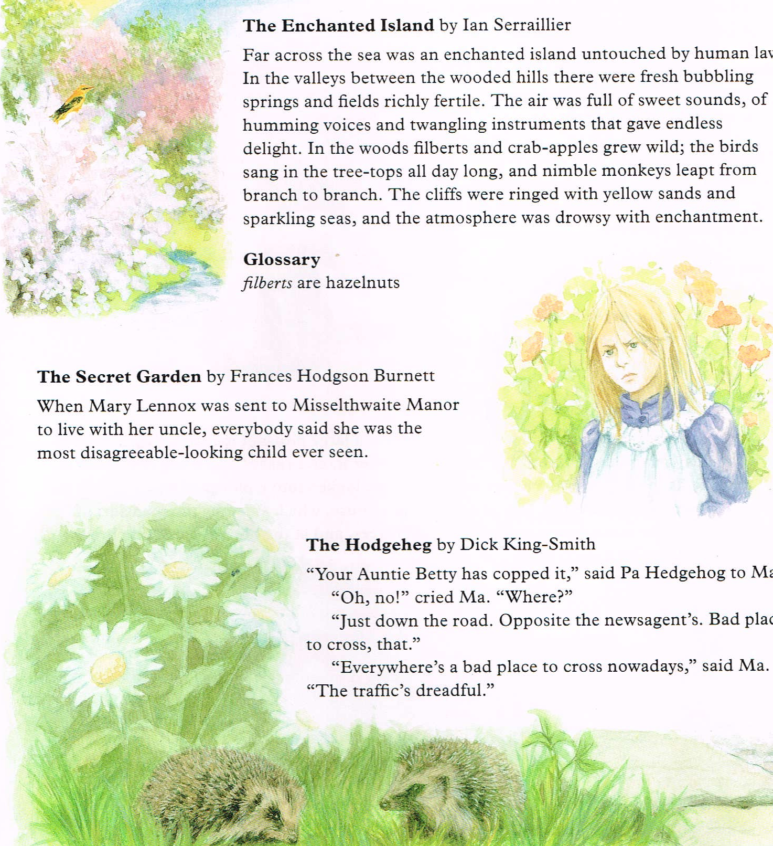
Guided Reading
This is a class / group activity that looks closely at a text.
For Year 3 it might look like this …

Slide 6
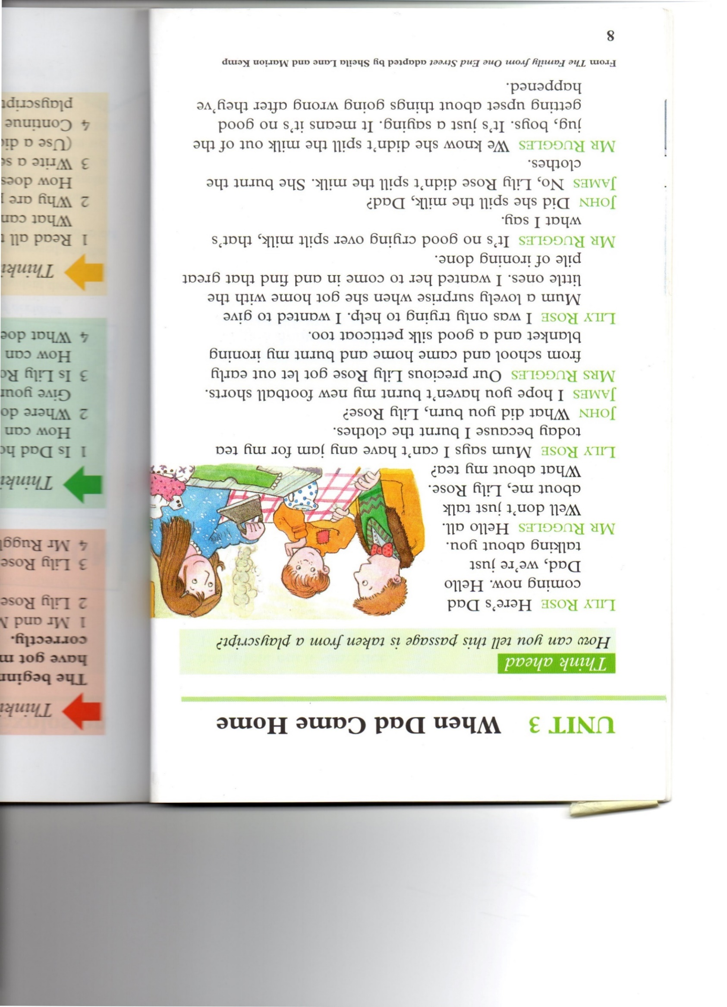
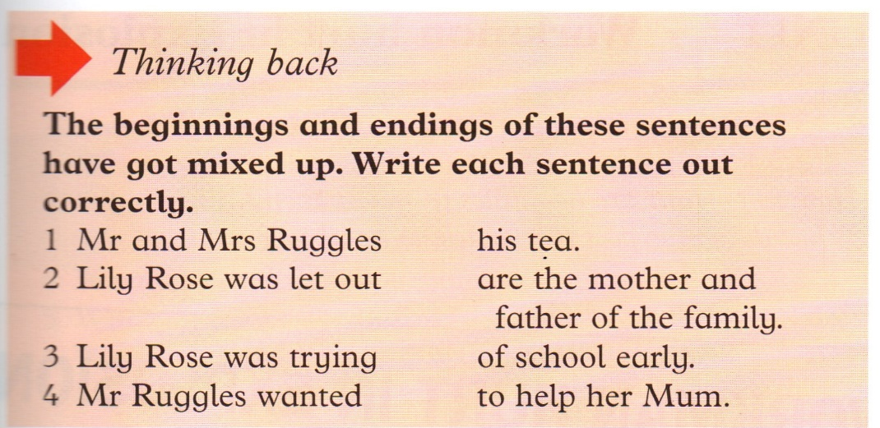

or something like this.

Slide 7
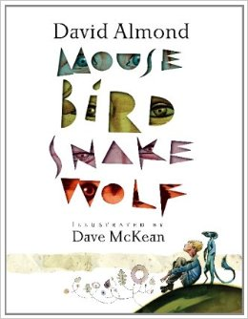
In Year 4
We use the texts from the Power of Reading
Our current text is

Slide 8
Guided Reading
Focuses on the skills of:
Inference and deduction
What is happening? Why did they do that? How are they feeling? How do you know? What clues are there?
Prediction
What is going to happen next? How did the text help you arrive at that conclusion?
Retrieval
Skimming and scanning to take quotes and information directly from the text

Slide 9
Guided Reading
Choice
Studying the vocabulary, types of sentence, characterisation and setting choices the author has made.
Viewpoint
Identifying the point of view of the characters in a text.

Slide 10
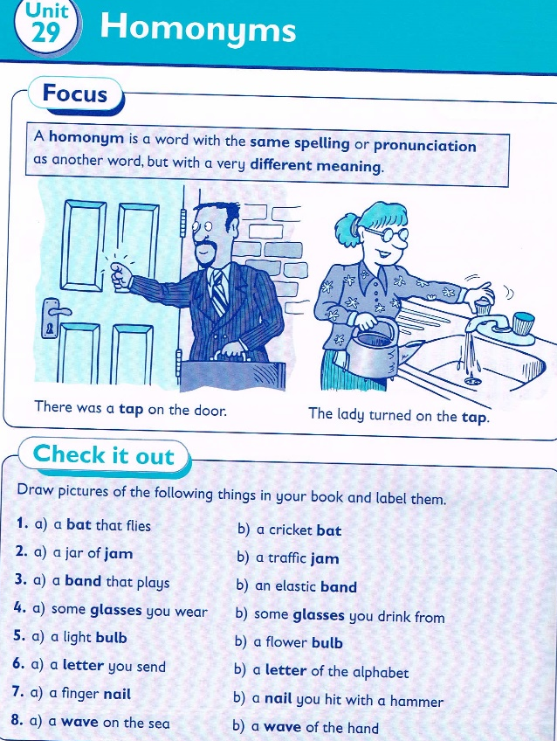
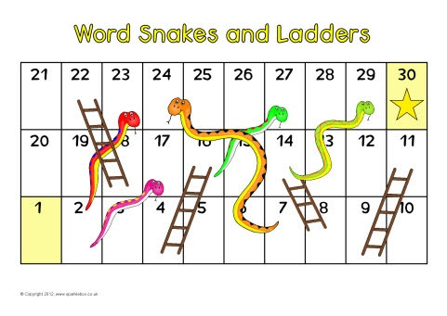
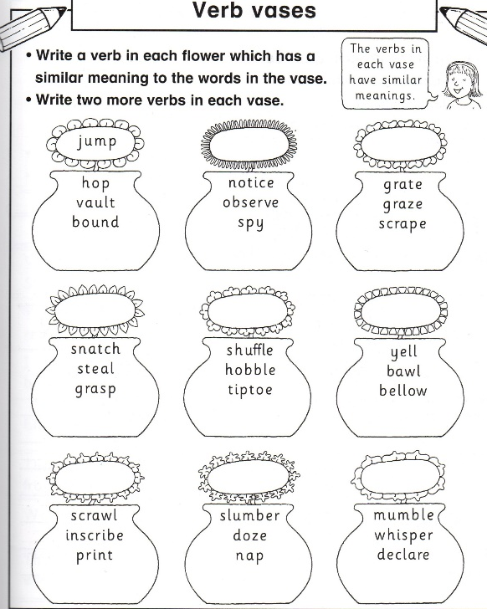
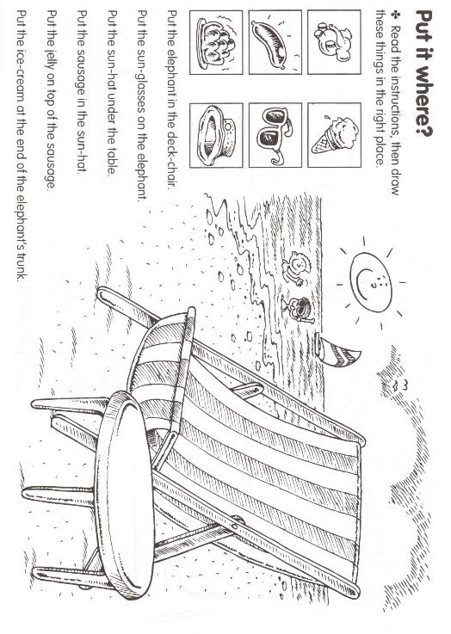
SPAG
Spelling, Punctuation and Grammar
These are focused lessons on specific aspects of language.

Slide 11
Clued Spellings
This is an individualized scheme where children work their way through a word list using games, look-cover-write-check and peer interaction.
In Year 3 these words also come home for extra practice.

Slide 12
Comprehension
Although Guided Reading has elements of comprehension there is also a weekly lesson specifically focused on answering comprehension questions about a text.
It is important for children to understand what is written for themselves and to make inferences and deductions beyond the text.

Slide 13
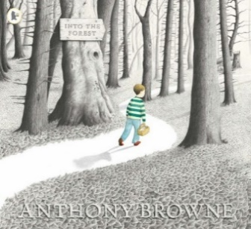





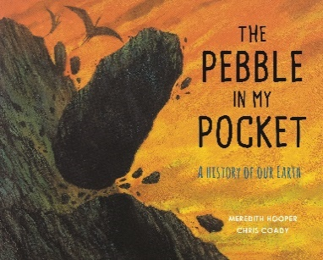

Power of Reading
Writing stories and non-fiction work using published texts as a model.
Year 3 texts

Slide 14


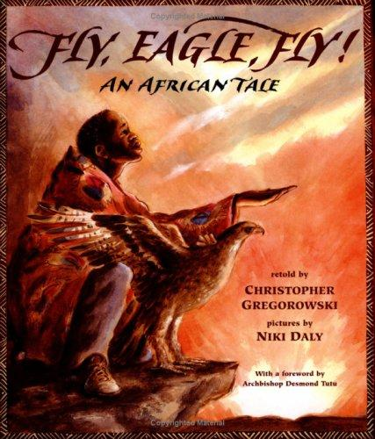


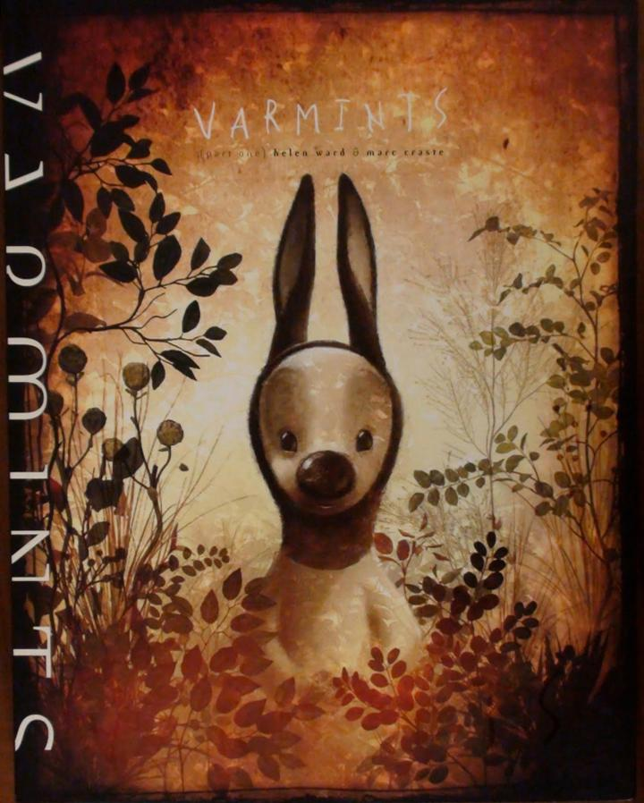
Year Four Texts

Slide 15
Pie Corbett
Using texts as a model for writing.
Three stages:
Imitation, Innovation, Invention

Slide 16
Imitation
First we learn the story by mapping it and acting it out.
We then can rewrite the story.

Slide 17
Innovation
Here we look at the structure of the story and begin to change elements of the story to make it our own.
We can then re-map our own story and write our own version.

Slide 18
Invention
This is where we take what we have learnt about the structure of a piece of writing and use it in something original, perhaps our own story or report or play script.

Slide 19
In Summary
English is the most important subject on the school curriculum, without it other subjects cannot be accessed and our understanding and learning cannot be expressed.

