Slide 1
Curriculum Evening Reading and Writing
With Miss Common and Miss Reynolds

Slide 2
What does the government say?
Pupils who can read are overwhelmingly more likely to succeed at school, achieve good qualifications, and subsequently enjoy a fulfilling and rewarding career. In addition to its substantial practical benefits, reading is one of life’s profound joys.
As pupils master decoding, it is vital that they are supported to develop speed and fluency, so that they become confident, mature readers. The best way to do this is to instil a passion for reading. Evidence shows that as the amount a child reads increases, their reading attainment improves, which in turn encourages them to read more. Reading widely also increases their vocabulary.
35 Clark, C and De Zoysa, S. (2011). Mapping the interrelationships of reading enjoyment, attitudes, behaviour and attainment: An exploratory investigation. National Literacy Trust.

Slide 3
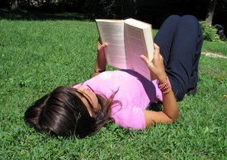
Where do you read?

Slide 4
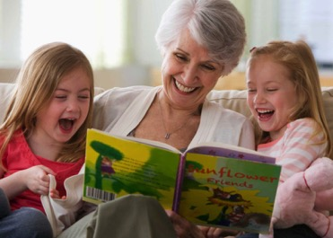
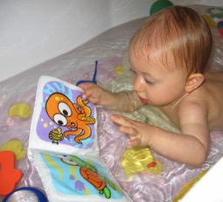
With kids?

Slide 5
When do you read?

Slide 6
What do the children need to know?

Slide 8
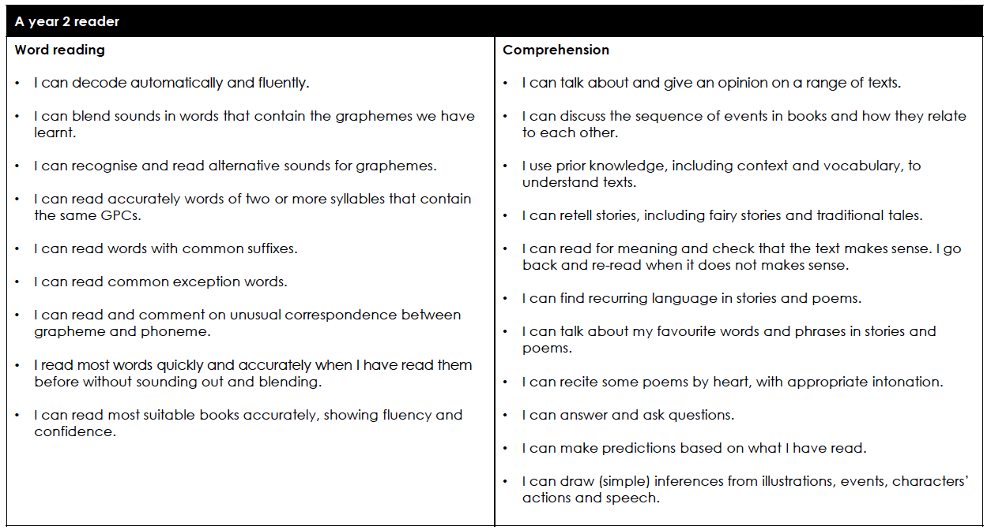

Slide 9
How do we teach reading?
Phonics
Guided Reading
1:1 Reading
Whole Class reading
Teaching the enjoyment of reading

Slide 10
What is guided reading?
The teacher works with a small group of children who are at the same developmental stage of reading
The teacher selects an unknown text that provides just the right balance of supports and challenges
The teacher reminds the children to use a range of reading strategies
The teacher uses questioning and other strategies to signpost the text and develop comprehension

Slide 11
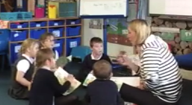
In guided reading sessions...
The teacher models how to read and explains to children what we need to do to make our reading better.
The teacher offers support to each child individually
The children are grouped to provide challenging, yet achievable reading goals based on their own ability.
Children can learn from one another

Slide 12
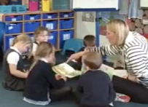
Hearing your children read individually in the guided reading session...
The teacher makes references to phonics or punctuation that has been learnt in class.
Children spend time practising and rehearsing.
We learn to listen to others read and use pictures to support our understanding of characters etc.

Slide 13
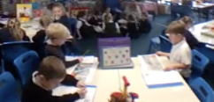
What’s the rest of the class doing?
In year One some children will be supporting their phonics learning through games
Others will be answering comprehension questions related to the text their reading.
In Year Two

Slide 14
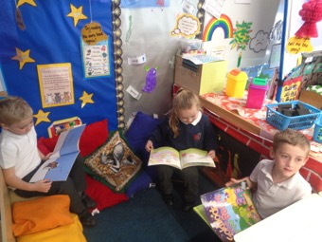
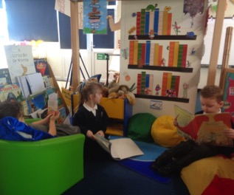
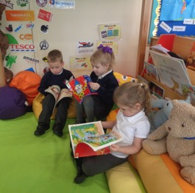
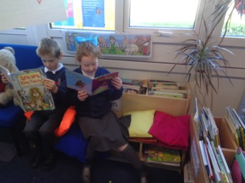
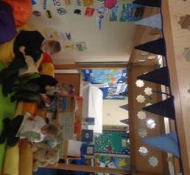
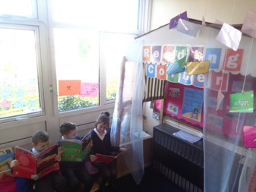
Book Corners

Slide 15
Reading in Year Two - SATS
The Reading Test consists of two separate papers:
Paper 1 – Contains a selection of texts totalling between 400 and 700 words with questions about the text.
Paper 2 – Contains a reading booklet of a selection of passages totalling 800 to 1100 words. Children will write their answers to questions about the passage in a separate booklet.
Each paper is worth 50% of the marks and should take approximately 30 minutes to complete, although the children are not being assessed at working at speed so will not be strictly timed.
The texts will cover a range of poetry, fiction and non-fiction.
Questions are designed to assess the comprehension and understanding of a child’s reading.
Some questions are multiple choice or selected response, others require
short answers and some require an extended response or explanation.
The Reading Test consists of two separate papers:
Paper 1 – Contains a selection of texts totalling between 400 and 700 words with questions about the text.
Paper 2 – Contains a reading booklet of a selection of passages totalling 800 to 1100 words. Children will write their answers to questions about the passage in a separate booklet.
Each paper is worth 50% of the marks and should take approximately 30 minutes to complete, although the children are not being assessed at working at speed so will not be strictly timed.
The texts will cover a range of poetry, fiction and non-fiction.
Questions are designed to assess the comprehension and understanding of a child’s reading.
Some questions are multiple choice or selected response, others require
short answers and some require an extended response or explanation.

Slide 16
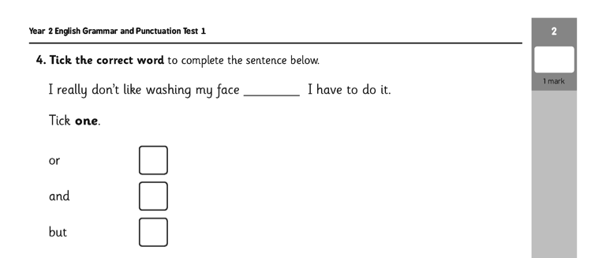
Sample SATS Questions
Grammar, Punctuation and Vocabulary Paper

Slide 17
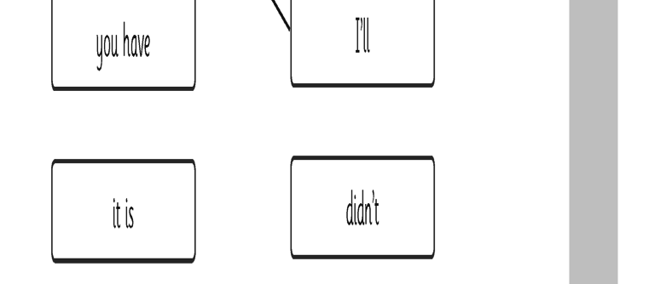
Sample SATS Questions
Grammar, Punctuation and Spelling Paper

Slide 18
READING WITH YOUR CHILD
Read to them every day.
Just before they go to bed is a good time … but not in front of the TV!
Be enthusiastic about the story … or choose another.
Allow the child to choose whenever possible. Yes, they will often choose their favourite over and over again … this is quite natural.
If you try to change the story, or leave bits out they will tell you very quickly!

Slide 19
10 mins every day you should be listening to your child read
Show your enjoyment … laugh, smile, look scared, look sad, sound excited, etc.
Spend some time just reading the pictures and talking about them.
Use lots of describing language when you read the pictures and invite the child to help you.
Run your finger along the line under the words as your child reads.
Invite the child to turn the pages over … you may need to guide their hand first.
Talk about the pictures … “Can you see the wolf hiding?”

Slide 20
Difficulties or mistakes for the child
If your child comes to a difficult word and stops, you may like to try some of the following ideas …
Ask them to look at the first letter of the word
Encourage sounding out each letter to build the word and blend the sounds together
Ask them to look at the picture for clues
Ask them to miss the word out and read to the end of the sentence. Then go back to the beginning of the sentence and make a guess. They could use the first letter of the word to help them
Ask them to look for any words they might know
Ask them to think about the story
Ask them to look for patterns in words eg ing, -ed, ight

Slide 21
The Home Reading Scheme
Read with your child every day
Read a variety of texts and reading material
Read picture books
Use your local library
Encourage your child to follow their interests
Encourage your child to read writing in different formats and presentations
Record all types of reading

Slide 22
Incentives to read!

Slide 23
Introduced this term to improve writing across the school. You can’t write a sentence if you can’t say a sentence.

Slide 24
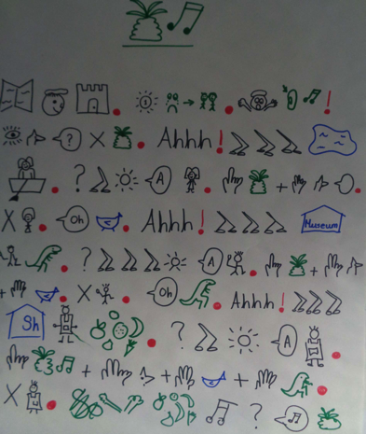
The children learn a high quality text off by heart! They use picture maps to help them remember the story / text

Slide 25
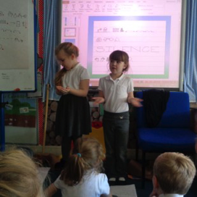
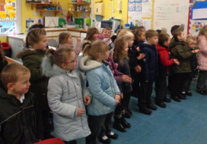
We play games with the text And present it out loud to our friends and other pupils

Slide 26
We learn how to adapt the text…. and then write our own version using key aspects of the structure or sentences that we learnt

Slide 27
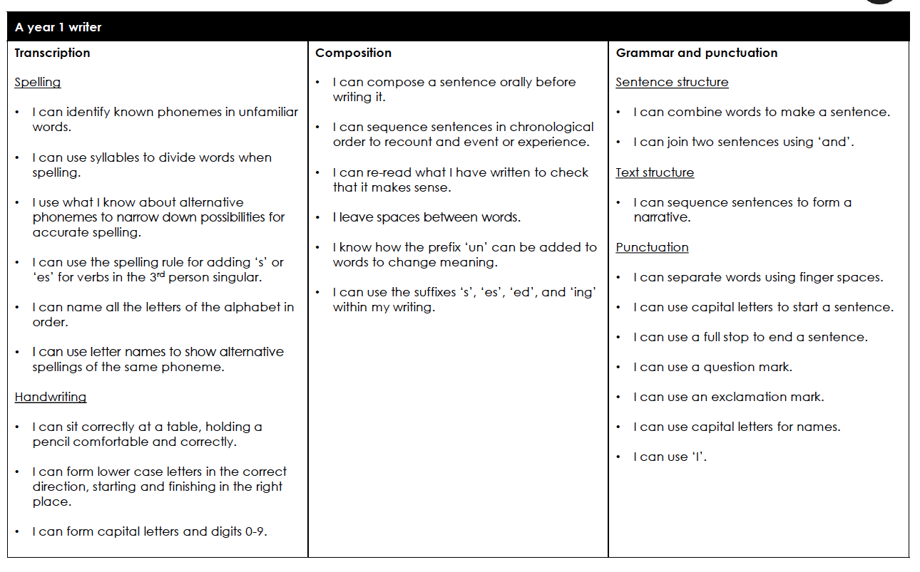

Slide 28
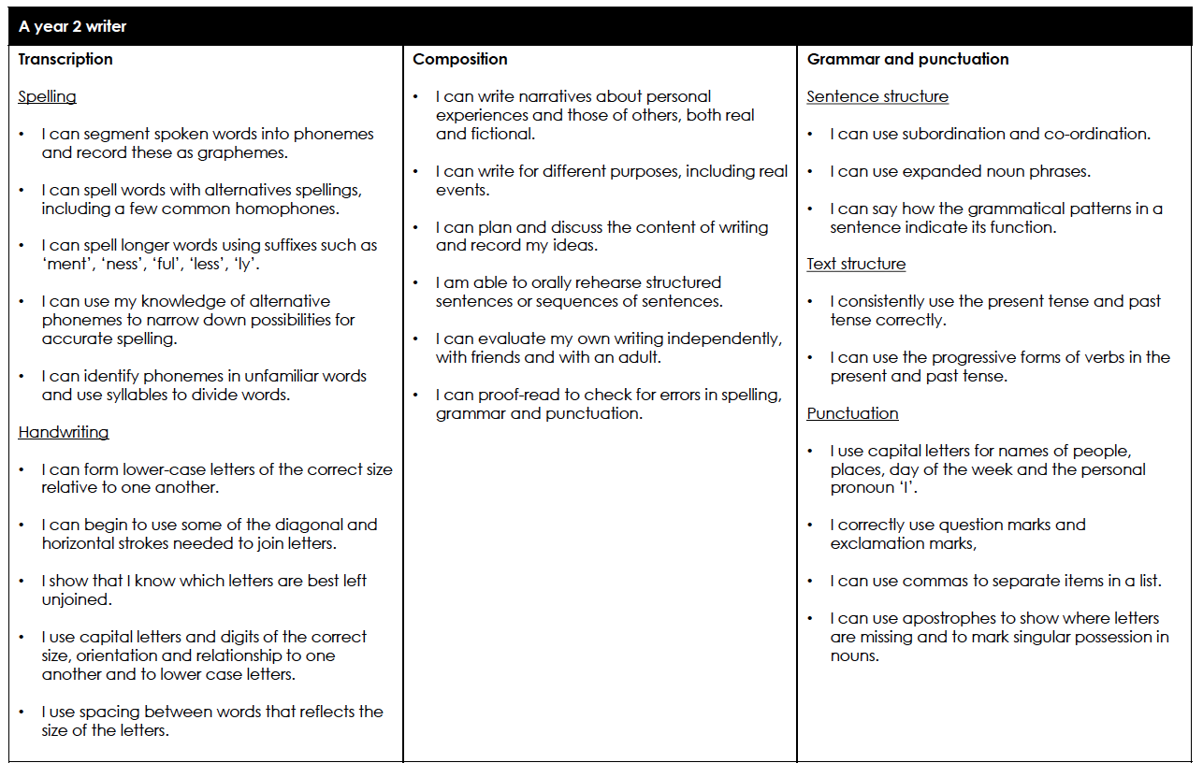

Slide 29
Any Questions?

