Slide 1
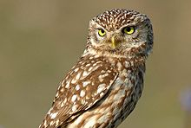
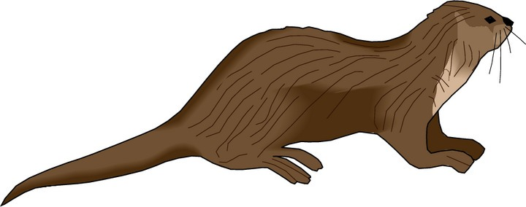
Curriculum Evening Maths at St Nic’s
With Mrs Lilly and Mrs Humphries

Slide 2
Our Classroom
Independent Learners
Smiles and laughter
Hands-on approach
Fun and exciting learning

Slide 3
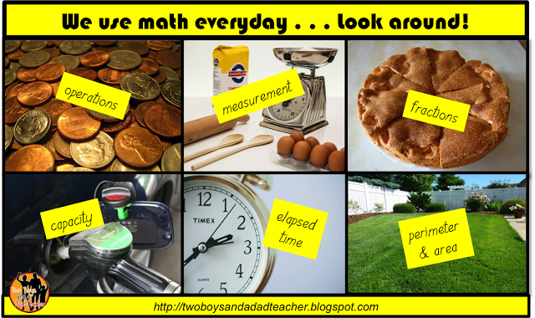
What Maths have you done today?

Slide 4
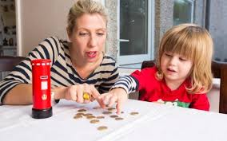
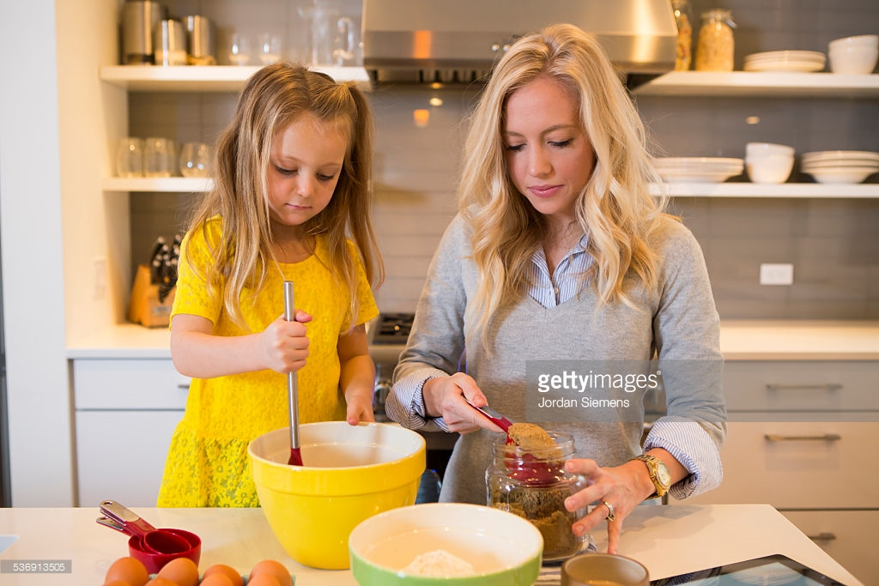
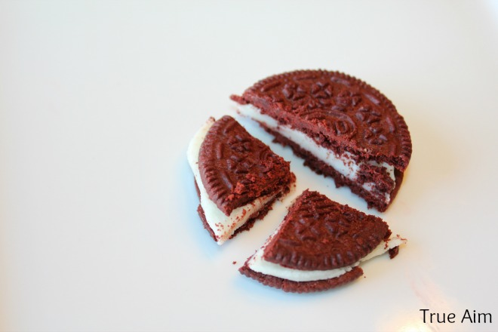
With kids?

Slide 5
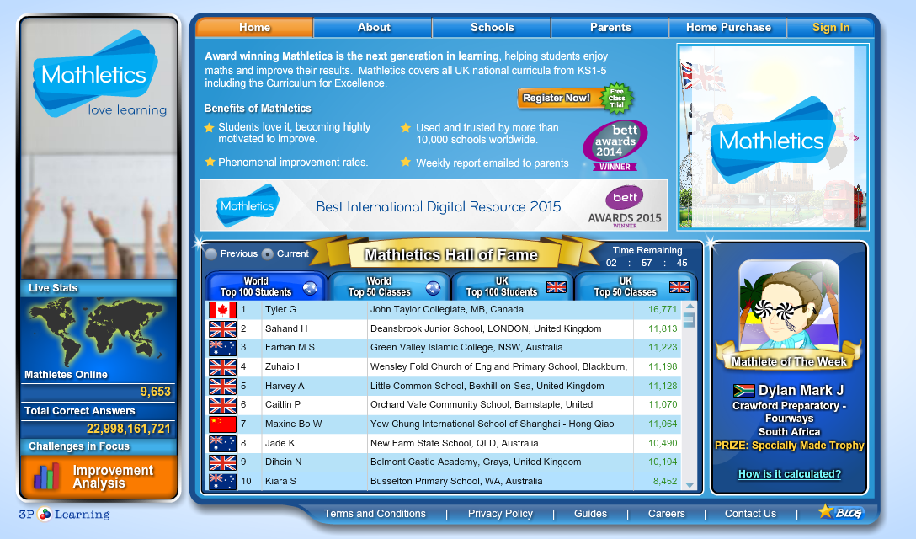
Incentives to complete maths at home and in school!

Slide 6
The New Curriculum: Maths
Children should:
Become fluent in the fundamentals of mathematics, including through varied and frequent practice with increasingly complex problems over time, so that pupils develop conceptual understanding and the ability to recall and apply knowledge rapidly and accurately.
Reason mathematically by following a line of enquiry, conjecturing relationships and generalisations and developing an argument, justification or proof using mathematical language.
Solve problems by applying their mathematics to a variety of problems with increasing sophistication, including breaking down problems into a series of simpler steps and persevering in seeking solutions.

Slide 7
Year 1 Objectives
Year 1 maths expectations
(New Curriculum) Number and place value
Counts to and across 100, forwards and backwards, beginning with 0 or one, or from any given number
Counts, reads and writes numbers to 100 in numerals; counts in multiples of twos, fives and tens
Given a number, identifies one more and one less
Addition and subtraction
Represents and uses number bonds and related subtraction facts within 20
Fractions (including decimals)
Recognises, finds and names a half as one of two equal parts of an object, shape or quantity
Measurement
Compares, describes and solves practical problems for:
1. lengths and heights eg long/short, longer/shorter, tall/short, double/half;
2. mass/weight eg heavy/light, heavier than, lighter than;
3. capacity and volume eg full/empty, more than, less than, half, half full, quarter; and
4. time eg quicker, slower, earlier, later.
Tells the time to the hour and half past the hour and draws the hands on a clock face to show these times
Properties of shape
Recognises and names common 2-D and 3-D shapes, including:
1. 2-D shapes eg rectangles (including squares), circles and triangles;
2. 3-D shapes eg cuboids (including cubes), pyramids and spheres.

Slide 8
Year 2 Objectives
Year 2 maths expectations
(New Curriculum)
Number and place value
Counts in steps of two, three, and five from 0, and in tens from any number, forward and backward
Compares and orders numbers from 0 up to 100
Uses < > and = signs correctly
Uses place value and number facts to solve problems
Addition and subtraction
Solves problems with addition and subtraction by:
1. using concrete objects and pictorial representations, including those involving numbers, quantities and measures; and
2. applying an increasing knowledge of mental and written methods.
Recalls and uses addition and subtraction facts to 20 and 100:
1. fluently up to 20.
Multiplication and division
Recalls and uses multiplication and division facts for the two, five and 10 multiplication tables, including recognising odd and even numbers
Solves problems involving multiplication and division, using materials, arrays, repeated addition, mental methods, and multiplication and division facts, including problems in contexts
Fractions (including decimals)
Recognises, finds, names and writes fractions 1/3, 1/4, 2/4, and 3/4 of a length, shape, set of objects or quantity

Slide 9
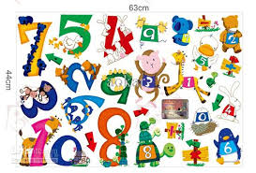
Number Sense!
Children need to understand our number system, starting with counting numbers, building an understanding of how our numbers work and fit together. This includes exploring place value and comparing and ordering numbers then
applying this understanding
in different contexts.

Slide 10
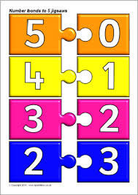
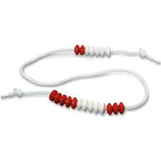
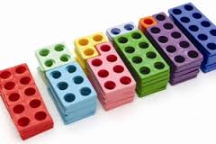
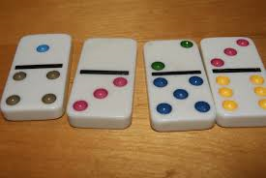
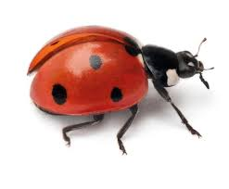
Recalling facts
It is important that children recognise number bonds, different pairs of numbers with the same total.
6 + 2
3 + 2
5
8
7 + 3
5 + 3
10
1 + 4
6 + 4
6 + 1
7
6 + 3
3 + 4
9
6
5 + 4
3 + 3

Slide 11
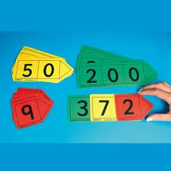
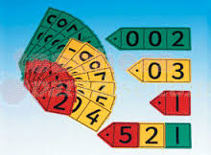
Place Value
Place value is at the heart of the number system. All digits have a value and a secure understanding of this will enable children to use and understand different calculation methods.

Slide 12
Year 2 maths test (2016)
https://www.gov.uk/government/publications/2016-key-stage-1-mathematics-sample-test-materials-mark-schemes-and-test-administration-instructions
There are two Maths papers for every child to complete. One is arithmetic only and one is a reasoning paper. There are examples of both on the tables.

Slide 13
In maths sessions...
The teacher has an explicit teaching role
The lesson usually begins a warm up activity. These are generally to improve and increase fluency.
Pairs of Numbers
If you have ten counters numbered 1 to 10 , how many can you put into pairs that add to 10 ? Can you use them all? Say how you got your answer.
Now put the counters into pairs to make 12 . Can you use them all?
Say how you got your answer.
Now put the counters into pairs to make 13 . Can you use them all?
Say how you got your answer.
Now put the counters into pairs to make 11 . Can you use them all?
Say how you got your answer.

Slide 14
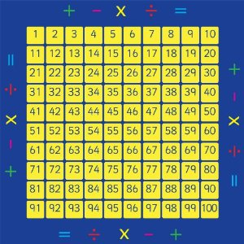
Independent Learning...

Slide 15
Year 1 Reasoning Question
Imogen and Bartek are using cubes to help their counting. They’re working out the answer to 13 + 7. Who has the correct answer? Explain your answer.
Imogen
Bartek

Slide 16
Making Numbers
The number 36 can be split in many different ways:
How many different ways can you make the number 36?
Try it with the number 24! How many different ways can you make 24?
Can you find more ways than your partner?
36
30 | 6
36
18 | 18
36
20 | 16
36 = 35 + 1
36 = 34 + 2
36 = 33 + 3
36 = 32 + 4
36 = 31 + 5
36 = 29 + 7
24 = 24 + 0
24 = 23 + 1
24 = 22 + 2
24 = 21 + 3
24 = 20 + 4
24 = 19 + 5
Show Answers

Slide 17
Year 2 Arithmetic Questions
1 | 5 + 7 =
5 | 15 + 3 + 3 =
2 | 19 − 9 =
3 | 89 + 10 =

Slide 18
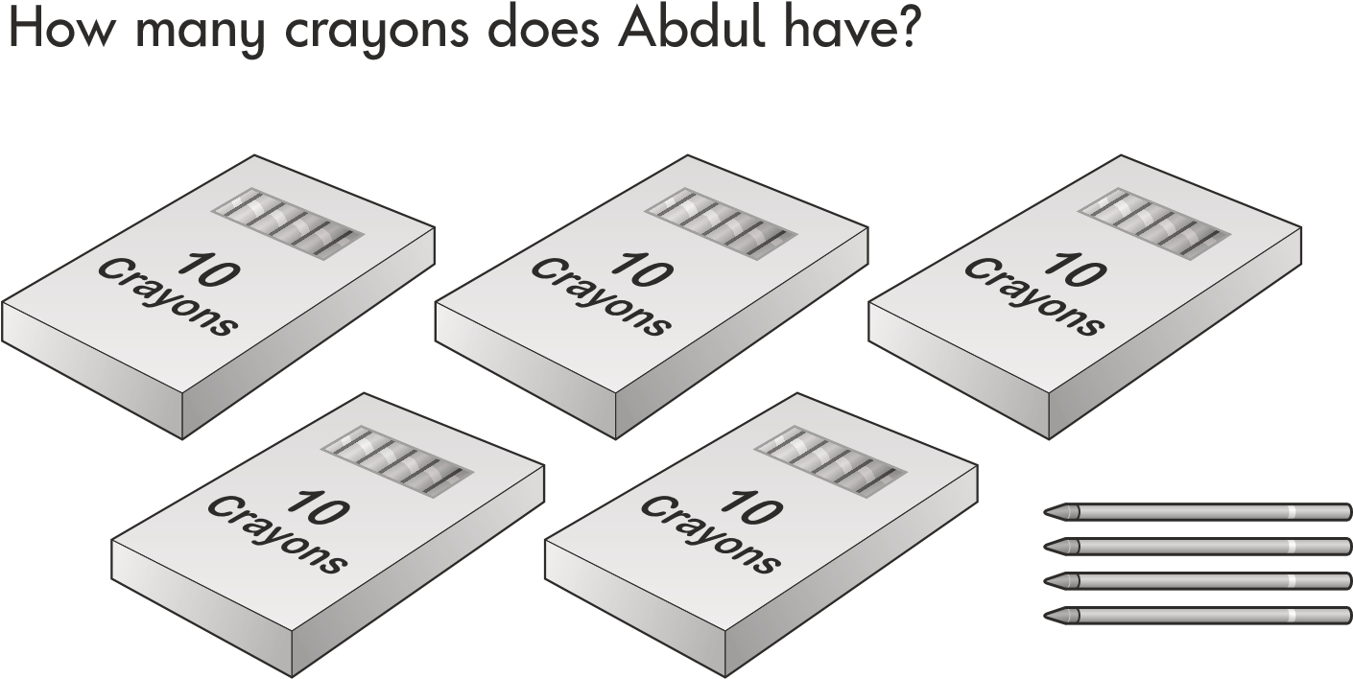
Year 2 Reasoning Questions
0
Use a ruler to measure the length of the toy car
3
6
12
18

Slide 19
What is the teacher’s role?
The teacher’s role is to…
group the children
prepare and structure the lessons
choose appropriate materials
prepare the teaching points
develop each child’s independence in order to solve maths problems

Slide 20
Supporting your child at home
Timestables – The children use their times tables every day. If they are fluent, it helps their progress in all areas of maths. Make it fun!
Be enthusiastic about maths
Help them to have a secure number recognition
Time – use this on a daily basis

Slide 21
Difficulties or mistakes for the child
If your child comes to a difficult problem with their maths learning, use the calculation policy to support them. The strategies in the policy are the strategies they will be used to using in school.
Make it practical – use counters, dried pasta, money, even sweets!
Ask them to have a go!
Be positive and give them lots or praise!
If they are finding something challenging, come back to it!

Slide 22
Any Questions?

